Slide 1
CONNECTION SETTINGS FOR
USE WITH THE
MOTION COMPUTING
MODEL-F5 TABLET COMPUTER
AKA: SIMON
(And other useful information.)
October 8, 2011

Slide 2
You must be connected to the company network in order to submit your weekly timesheet, perform your BACC modules, and to participate in the Performance Management program.
To access the company network you must work through the VPN process to establish a secure connection. When properly done, you will be connected to the network and will have access to the shared drives and resources you are used to accessing through ROVA.
The VPN process involves the Nortel VPN Client application that can be accessed through the Nortel icon on your tablet desktop. Access through the Nortel portal will require use of the SecureID fob you were issued, as well as the PIN you were assigned by the Bridgestone Service Desk. If you need to reset your PIN call the Service Desk at 330-379-4357.
To be successful, you will need a basic understanding of the various internet settings involved. This guide is intended to help you understand how to configure your tablet for full functionality. In addition to sending this guide to you, we will also post a copy on the QBS Links page that can be accessed by any computer if you know the address (just ADD “/qbslinks.aspx” to GenFlex.com).
In addition to this guide there are many teammates in the field with a very strong computer ability. Ask for help if you need it – it’s never far away.
NOTE: If you forget to configure your Internet Explorer correctly before logging into the VPN portal you will need to log off the VPN, configure according to your connection type, and then reconnect to the VPN. Changes made while connected will not help you access the network folders or Documentum.

Slide 3
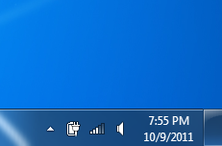
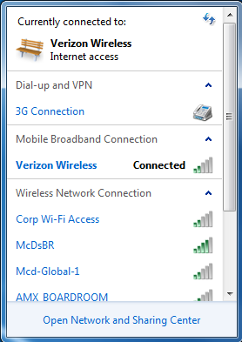
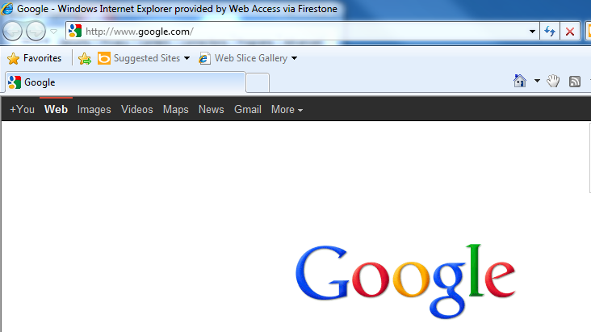
3G Wireless Connection
There are three basic connection configurations for the F5 Tablet that you need to know.
The first is the simplest – the basic 3G wireless connection. This connection is all that is needed for SIMON to work correctly. This connection is nothing more than the 3G wireless service in the connect position. Here are the steps to check service.
To Open This Screen
Click Here
A good connection can be verified by going to Google.com
IMPORTANT: If you cannot access Google.com, SIMON will not be able to upload and download data. This is the first check to make when troubleshooting SIMON.

Slide 4
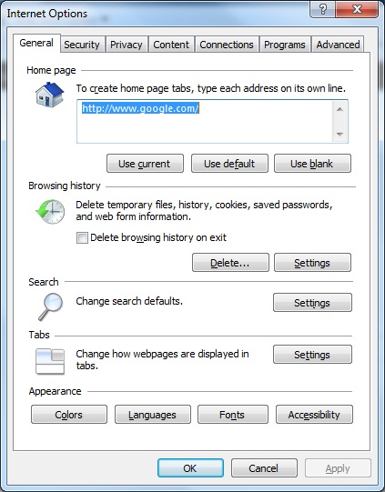
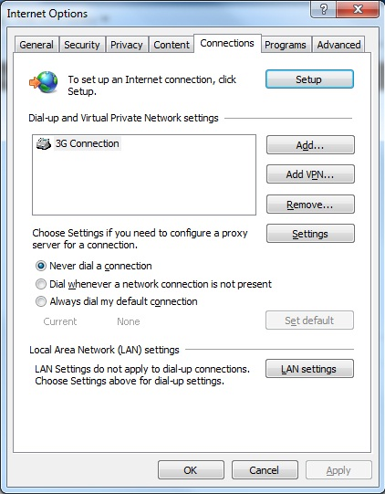
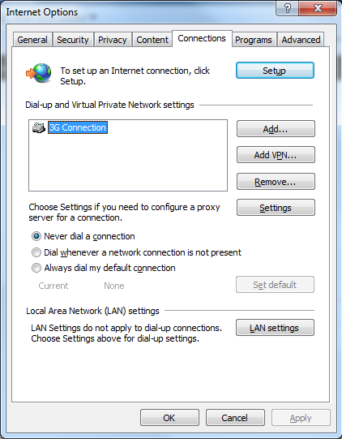
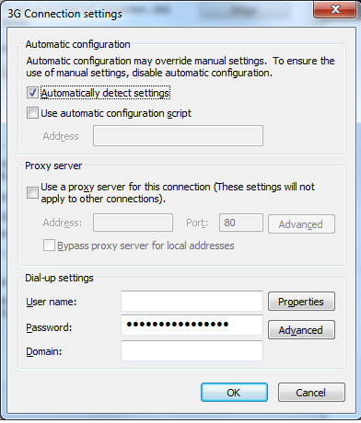
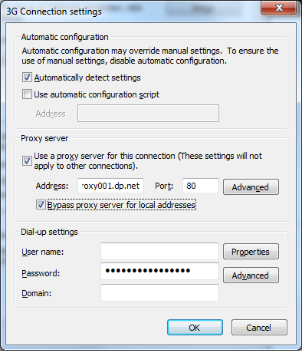
3G Wireless Connection
Configured For VPN Access
The second connection configuration for the F5 Tablet that you need to know is the 3G connection for VPN access.
This connection is the basic 3G wireless connection with the proxy settings turned on in the 3G area of Internet Explorer.
1.
From Internet Explorer click “Tools” and then click “Internet Options” to open this panel.
2.
Click “Connections” to open this panel.
3.
Click “3G Connection” to open this panel.
4.
Click the Proxy Server box and type the following into the address box:
usindmvproxy001.dp.net
Then type 80 in the port box.
And lastly, click the “Bypass proxy server for local addresses” box.
Resu lt
Once configured as shown, click the Nortel Client icon on the desktop and proceed accordingly.

Slide 5
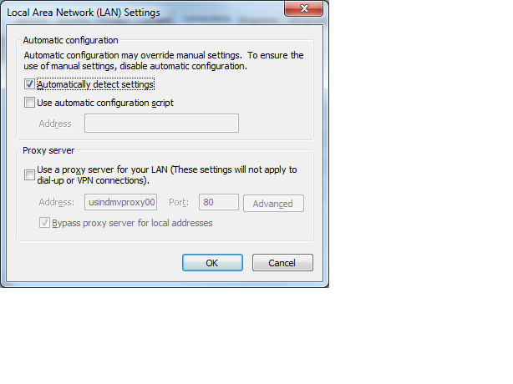
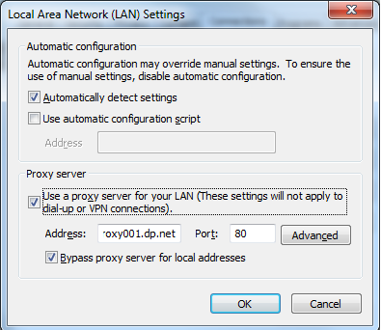
WiFi or Hard Line Connection
Configured For VPN Access
The third connection configuration for the F5 Tablet that you need to know is the WiFi or Hard Line connection for VPN access.
This connection is similar to the 3G wireless connection with the proxy settings turned on in the LAN settings area of Internet Explorer versus the 3G area.
1.
From Internet Explorer click “Tools” and then click “Internet Options” to open this panel.
2.
Click “Connections” to open this panel.
3.
Click “LAN settings” to open this panel.
4.
Click the Proxy Server box and type the following into the address box:
usindmvproxy001.dp.net
Then type 80 in the port box.
And lastly, click the “Bypass proxy server for local addresses” box.
Once configured as shown, click the Nortel Client icon on the desktop and proceed accordingly.
Result

Slide 6
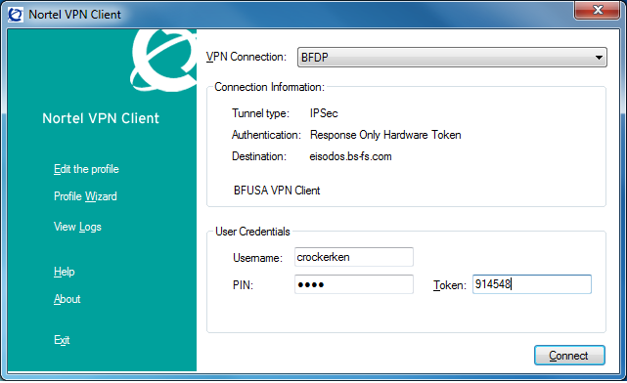
NORTEL VPN CLIENT APPLICATION
Enter the username assigned to you by the Service Desk.
Enter the PIN assigned to you by the Service Desk.
Enter the current 6-digit security code.
Click “Connect”.
Pay attention to the status messages in the client box in case there is an error –
you will need to know the cause of any issue if you seek help.
Troubleshooting tips:
(If you cannot get through the VPN login work through these steps in order.)
Verify you are using the correct username. Unless you have accessed the VPN before using the username you just entered, don’t assume the username is the same one you use to access your computer. We found that four different username variations have been used depending on who processed your ticket – the variations we have identified so far include – 1) last name alone, 2) 1st Initial + last name, 3) 1st and middle initial + last name, 4) last name + first name. Solution: The e-mail you received from the Service Desk should contain your username in it. If not, contact the Service Desk for assistance.
If everything is being done correctly and you still cannot get past the login, your SecureID may need to be re-synced with the server. They have told us that the fob will become offset from the server after awhile and need to be re-synced. Solution: Contact the Service Desk for assistance.
You are connected but cannot access any network drives or Documentum. Check your proxy settings in Internet Explorer and make appropriate corrections, log-off the VPN and then re-login with the proxy settings in the correct positions.

Slide 7
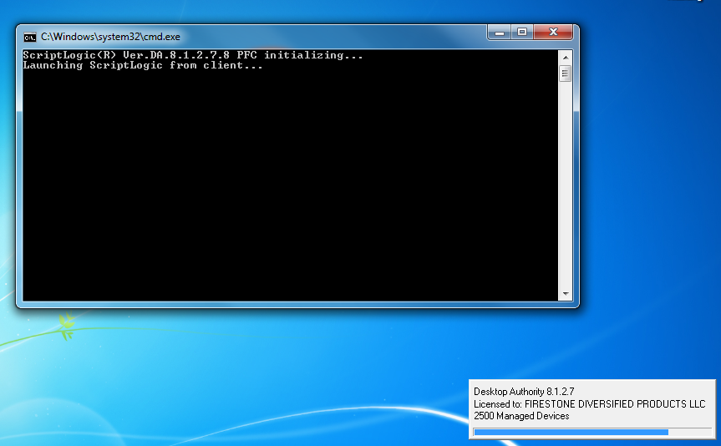
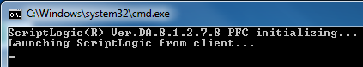
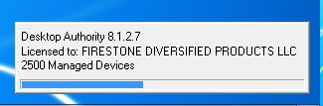
NORTEL VPN CLIENT APPLICATION
A correct login through the VPN will allow the scripts shown below to run which are required to map the drives you have access to. Wait until the scripts have fully run before trying to access the network.
Enlarged for easier viewing…

Slide 8
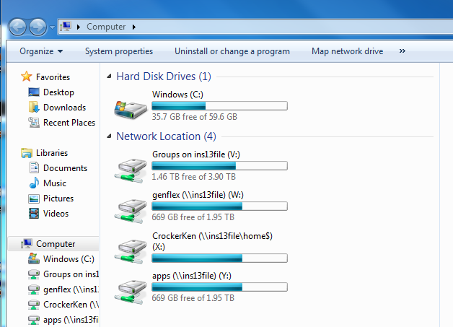
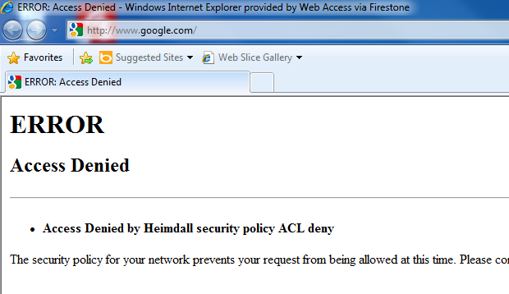
NORTEL VPN CLIENT APPLICATION
After the scripts run, you will have access to all the drives assigned to your login.
If you try to access Google, or other external sites, while connected through the VPN you will receive an error message. This is correct and not indicative of a problem.

Slide 9
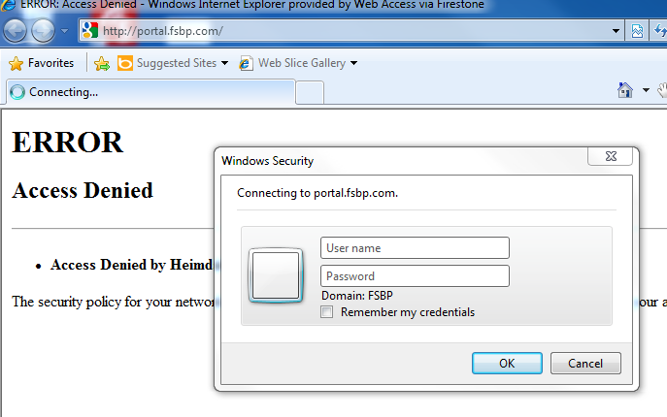
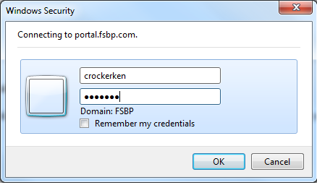
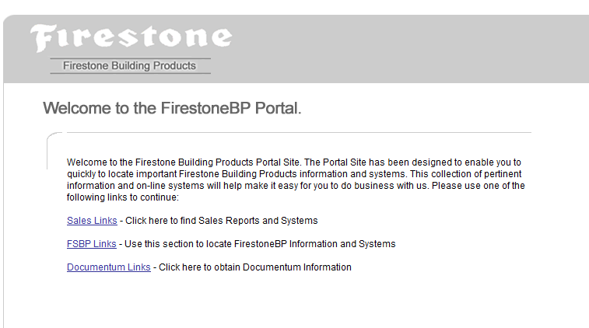
NORTEL VPN CLIENT APPLICATION
When you attempt to access Documentum via the portal you will be prompted fro your credentials. This is because your connection is being routed through BSA’s network and the VPN connection does not transmit your identity to the BFDP network.
Type in your username and password then click OK.
And the portal will be made available to you.
NOTE: If your VPN and computer login usernames are different, use your computer login name here.

Slide 10
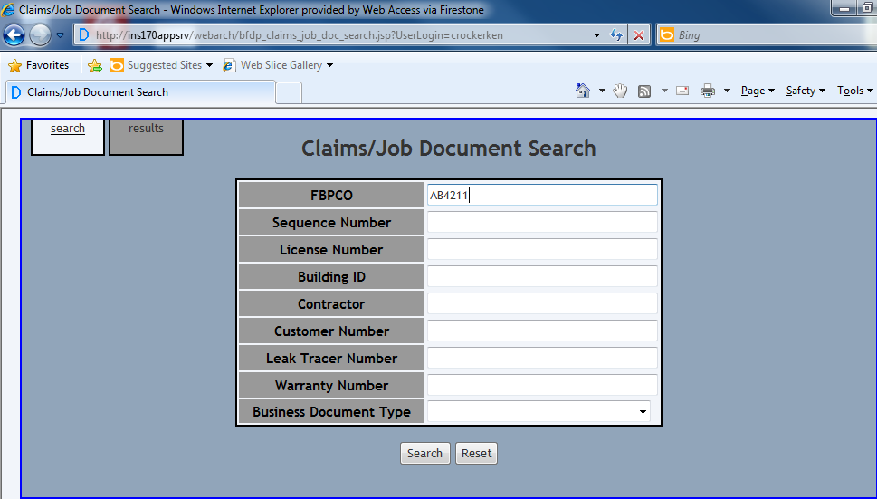
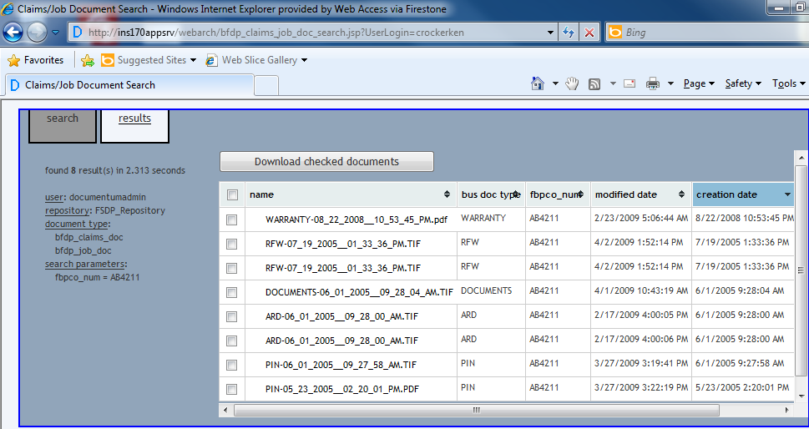
NORTEL VPN CLIENT APPLICATION
Here is an example of a Documentum search conducted following a correct VPN login with the correct proxy settings.
Here is an example of the results of that search. NOTE: Numerous people have complained that they could only download one file at a time or that the search would just hang up. If this happens, check your proxy settings and make the appropriate corrections, log-off the VPN, and then log back on with the correct settings. Changes made while connected will not help you until you exit and re-enter the network (the scripts have to run).

Slide 11
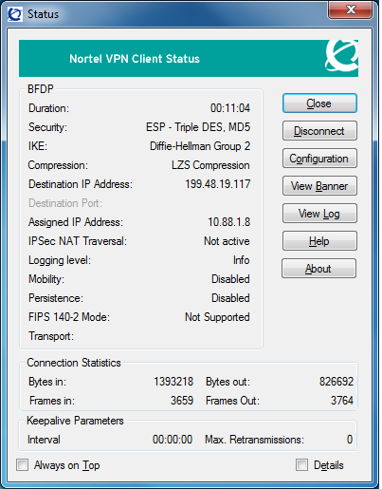
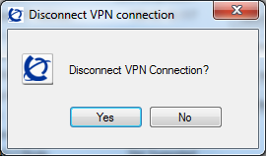
NORTEL VPN CLIENT APPLICATION
When all done with your VPN session, click Disconnect and confirm to exit the VPN Client.

