Slide 1
FIRESTONE Asphalt Roofing

Slide 2
Agenda
Asphalt basics
Modified Bitumen
Attachment methods
Mopped into base sheet with asphalt
Torch applied onto base sheet
Fully adhered with MB Cold Adhesive
Self Adhered Base Sheets
Installation basics
Do’s & Don'ts

Slide 3
Asphalt
Highly waterproof and durable
Naturally strong adhesive
Used for waterproofing dating back to the ancient Egyptians
Resistant to most acids, alkalis and salts

Slide 4
Asphalt Roofing
Hot asphalt is the adhesive and the waterproofing between Built-Up Roofing layers (plies).

Slide 5
Residual Asphalts from Petroleum Distillation
Fuels
Lubricants
Plastics
Petrochemical
Asphalts

Slide 6
Asphalt Terminology
Blowing temperature
Softening point
Equiviscous temperature (EVT)
Asphalt fallback
Flash point
Alligatoring

Slide 7
Blowing Temperature
Asphalt used for roofing applications is treated (oxidized) by blowing air through it at elevated temperatures to give it desirable characteristics
Higher blowing temperatures result in asphalts with higher viscosity or less flow

Slide 8
Equiviscous Temperature (EVT)
EVT, the temperature at which a bitumen attains the proper viscosity for BUR application-it is marked on every container

Slide 9
Softening Point
The temperature at which the asphalt changes from a moldable solid to thick, flowing liquid
Commonly confused with the melting point
Four different grades of roofing asphalt are defined by ASTM Standard D312

Slide 10
Asphalt Fallback
When asphalt is heated to extreme temperatures or held above its final blowing temperature it will soften.
This phenomenon is called “fallback” because the asphalt has become softer than it was when it was packaged.
Slippage is the most common problem associated with asphalt fallback
Most manufactures require a minimum Type lll asphalt due to lower softening points of Types 1&2
Steep asphalt is more susceptible to softening-point fallback than dead level

Slide 11
Flash Point
The temperature at which the asphalt vapors will ignite momentarily in air, in the presence of a small flame
Kettle and tanker temperatures are usually maintained at 25° below the flash point

Slide 12
Temperature Comparison
Flash point
Asphalt fallback
Final blowing
temperature
Equiviscous
temperature (EVT)
Softening point

Slide 13
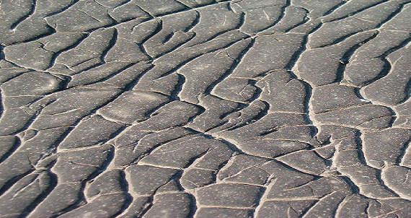
Asphalt Aging
“Alligatoring”
Is the cracking of the surfacing bitumen on a bituminous roof or coating on a SPF roof, producing a pattern of cracks similar to an alligator’s hide. The cracks may not extend completely through the surfacing bitumen or coating
Left unattended, cracks and splits eventually develop. Water will pierce the roofing system and cause undetected damage in the roof system. As the surfacing layer fails, the fiberglass reinforcement underneath is exposed and becomes brittle. Membrane failure inescapably follows

Slide 14
Mopping Asphalt Types
Mopping Asphalt is typically applied with a cotton or fiberglass mop

Slide 15
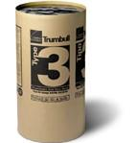
Roofing Asphalt
Typically Comes in 100 pound kegs
Must be broken up into pieces and melted prior to application

Slide 16
Rubber Modified Mopping Asphalt
ASTM D 6152, SEBS Mopping Asphalt
SEBS is a heat and light stable rubber polymer for use as a mopping asphalt
Tough and flexible polymer modified bitumen

Slide 17
ASTM D-312 Asphalt Types
Softening Point
/Maximum slope, in./ft
Type I
Dead level asphalt
135° to 151° F
158° to 176° F
185° to 205° F
210° to 225° F
Type II
Flat asphalt
¼” per. ft
Type III
Steep asphalt
Type IV
Special steep asphalt
(Required for 20 year a Red Shield Warranty)
1 ½” per. ft
3”per. ft
6” per. ft

Slide 18
Why Hot Asphalt is Disappearing
Trained applicators declines annually
Continuous monitoring during application is required to guaranty the quality of the finished roof
Declining number of asphalt refiners
Cost of crude oil is unpredictable
Onsite hazards associated with 450ºF material curtails building owner acceptance
Asphalt paving uses 90% of US asphalt
Limited availability during the paving season, April to October
Transporting hot asphalt by tank truck requires a special license and increased insurance

Slide 19
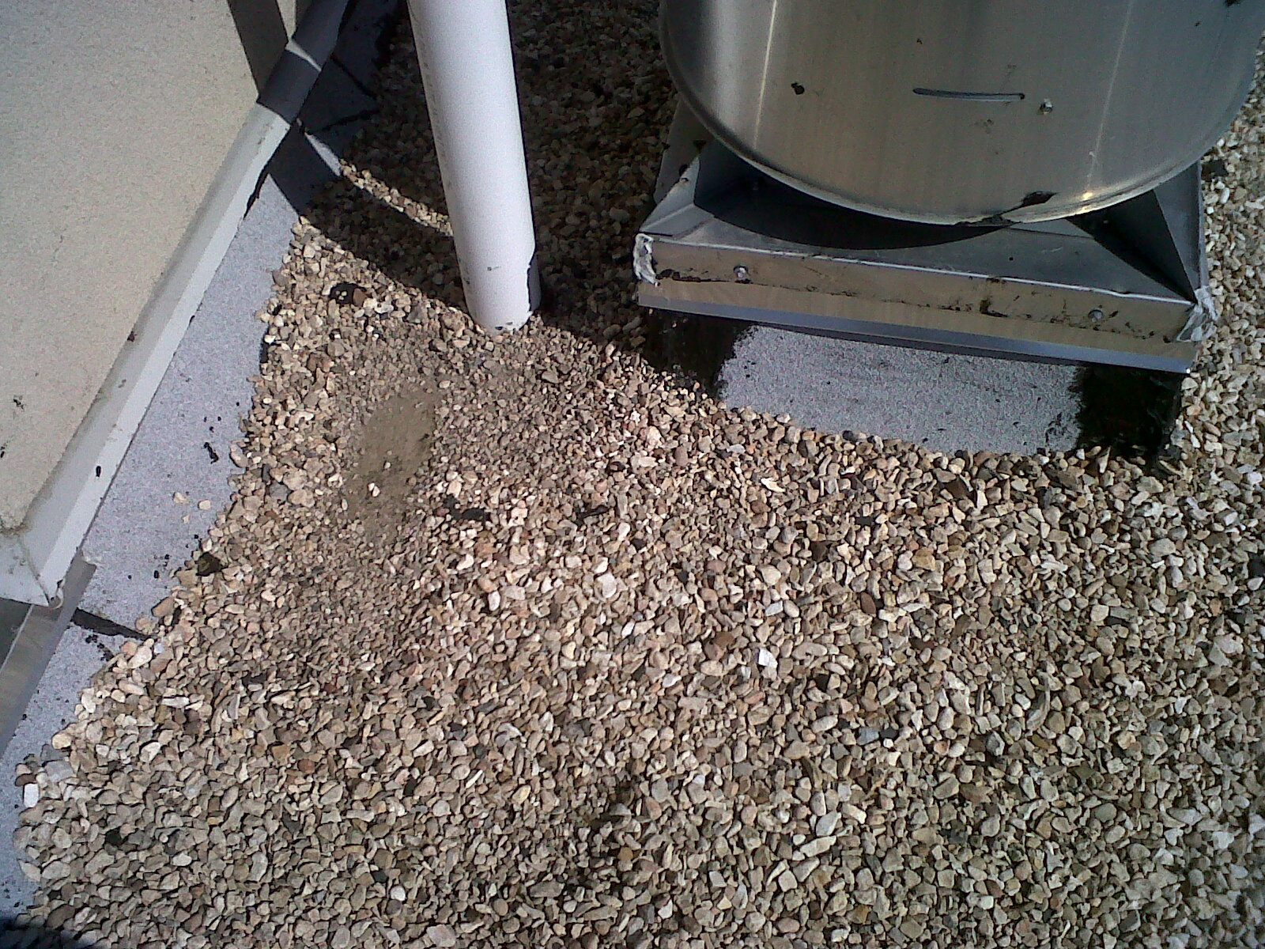
3-Coursed Outside Corners Is Not An Approved FIRESTONE Detail

Slide 20
Modified Bitumen System Types, Coatings and Application Methods

Slide 21
Modified Bitumen Roof Membranes
Two types
SBS - Rubber
APP - Plastic

Slide 22
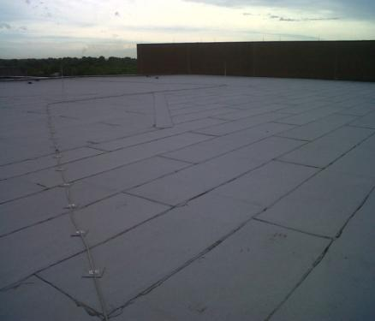
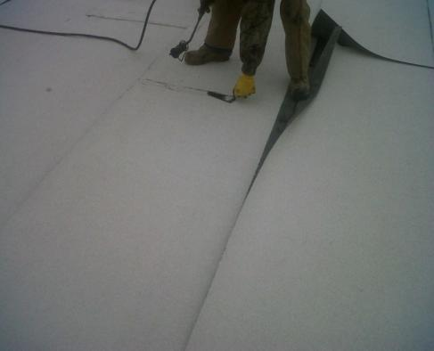
Granule Surfacing
APP and SBS systems:
Aesthetics
Many colors available
ULTRAWHITE & Acrylic coated meet EPA Energy Star criteria

Slide 23
WHY COATINGS
Fiberglass mat near the top of a modified sheet will not stop deterioration

Slide 24
New High Reflectivity Products for Asphalt
Two Coat Acrylic Roof Coating System
First acrylic coating systems that
Bond well to smooth asphalt: BUR or APP
Do not stain from asphalt oils
Improve ponding performance
Meet EPA Energy Star and the Cool Roof Ratings Council requirements for both reflectivity and emissivity
No aluminum coating can do this

Slide 25
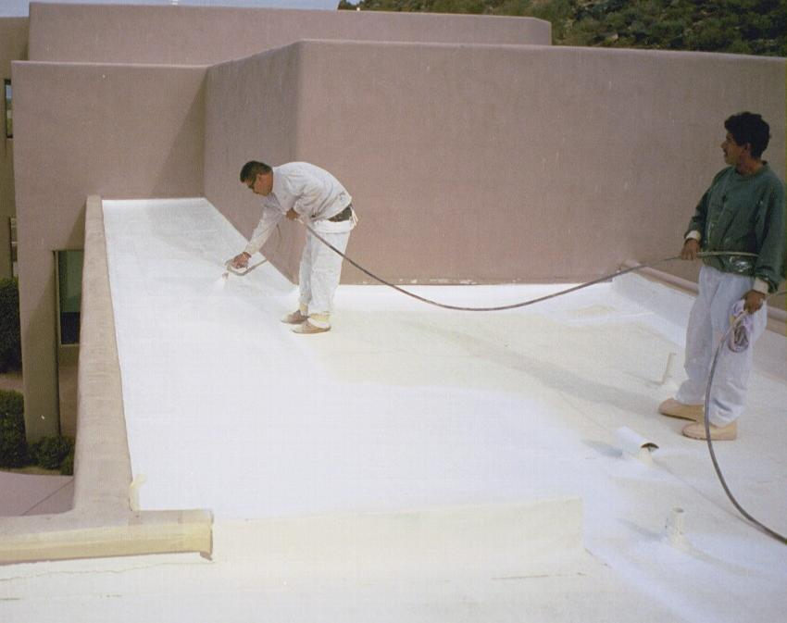
Two Coat Acrylic Roof Coating System
Acrylic Top Coat being spray applied over Base Coat on a six year old APP Granule roof in AZ

Slide 26
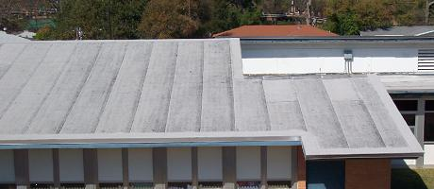
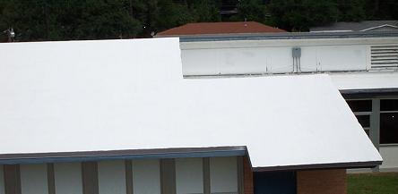
Acrylic Roof Coating System on Granule Surfaced Modified Bitumen
Before
After

Slide 27
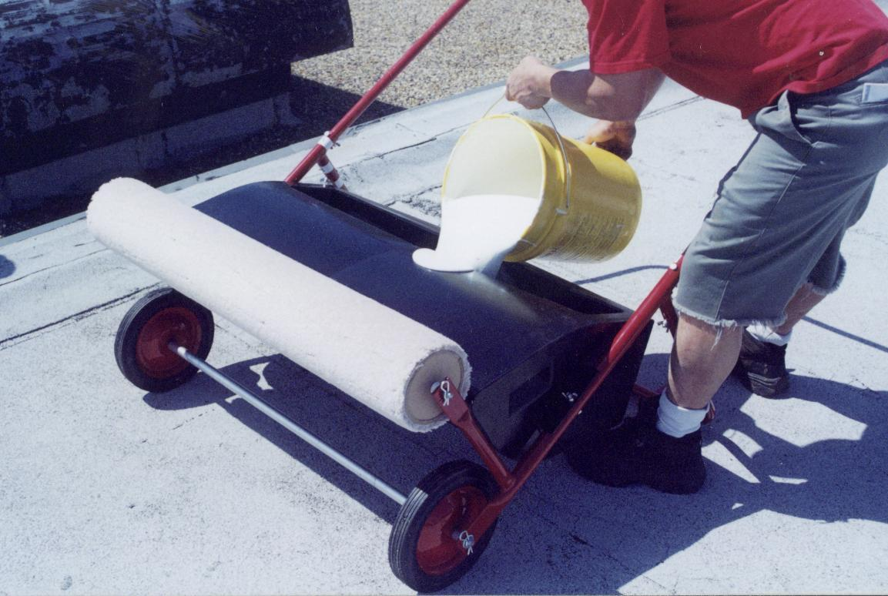
Acrylic Base Coat with SuperSpreader
over SBS Granule roof

Slide 28
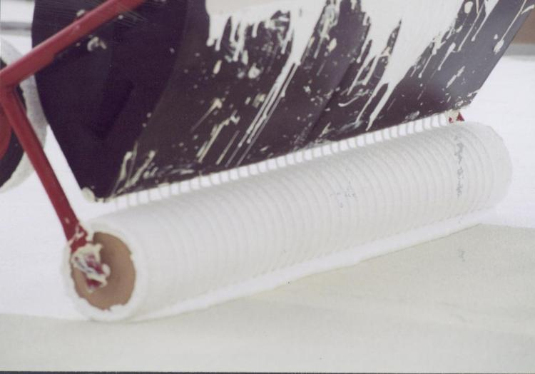
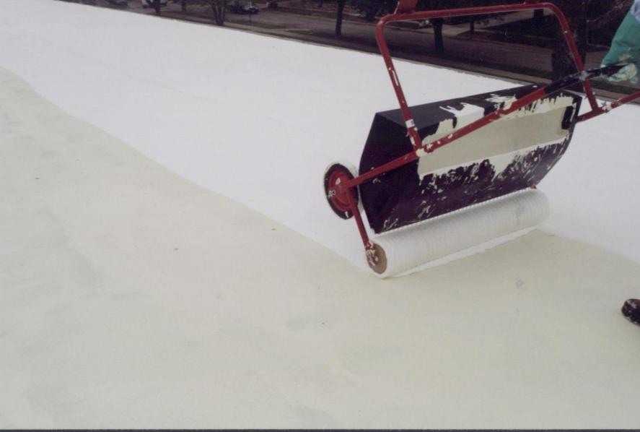
Acrylic Base Coat

Slide 29
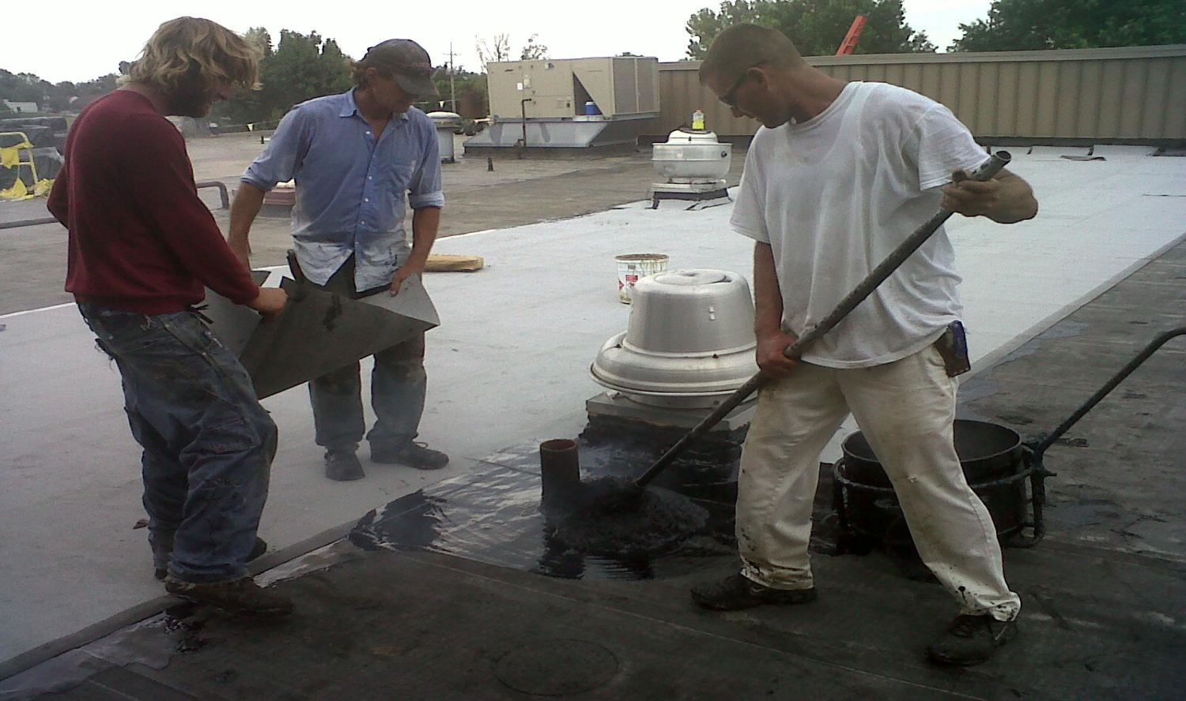
SBS Hot Asphalt Application
The asphalt temperature must be a minimum of 400°F at the point of contact with the membrane. Asphalt must be type III or IV or Firestone SEBS asphalt.

Slide 30
Hot Application Requirements
Remove all of the roll tape before installing the SBS sheet.
The asphalt temperature must be a minimum of 400°F at the point of contact with the membrane. Asphalt must be type III or IV or Firestone SEBS asphalt.
Allow rolls to relax prior to installation. Re-roll just prior to installation.
Laps of SBS cap sheet should never fall on top of base sheet laps.
Cut bottom sheet laps at a 45° angle as shown in Firestone Detail MB-LS-1.
Bleed-out should be no more than 3/4" wide
All side laps must be a minimum of 3” and all end laps must be a minimum of 6”
Broadcast granules in bleed-out.

Slide 31
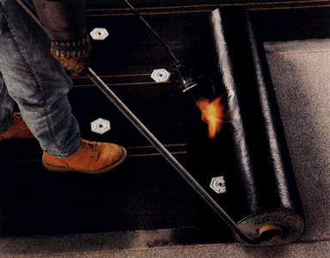
APP Torch Application

Slide 32
APP Torch Application
Remove all of the roll tape before membrane installation.
Allow rolls to relax prior to installation. Re-roll just prior to installation.
Laps of SBS cap sheet should never fall on top of base sheet laps
All side laps must be a minimum of 3” and all end laps must be a minimum of 6”
Using a "hook" or "cane" tool to move the roll, heat weld the re-rolled portion of the sheet. DO NOT STEP ON FRESHLY HEAT WELDED SHEETS! Be alert to insure the lap area of the installed sheet is heated, as well as the bottom of the sheet being applied.
The welding temperature is correct when a 1/8 to ¼ inch wide flow of bitumen is extruding from the side lap.
Cut bottom sheet laps at a 45° angle according to Detail MB-LS-1.
Embed granules on the receiving surface by heating the surface and toweling-in all granules until a uniform black surface coated with compound is achieved.

Slide 33
Cold Adhesive Application
¼ inch notched neoprene squeegee
delivers proper amount of cold adhesive

Slide 34
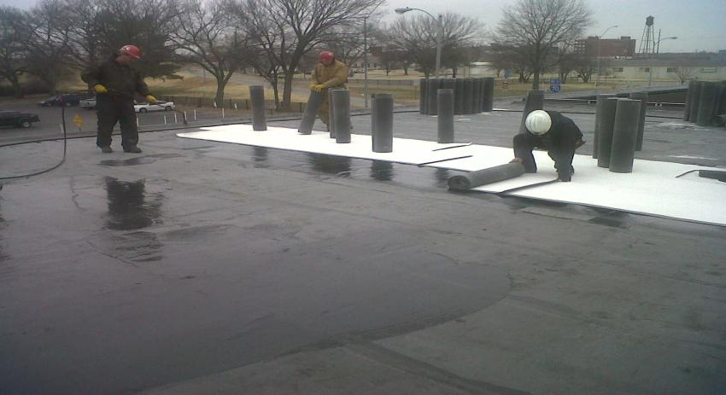
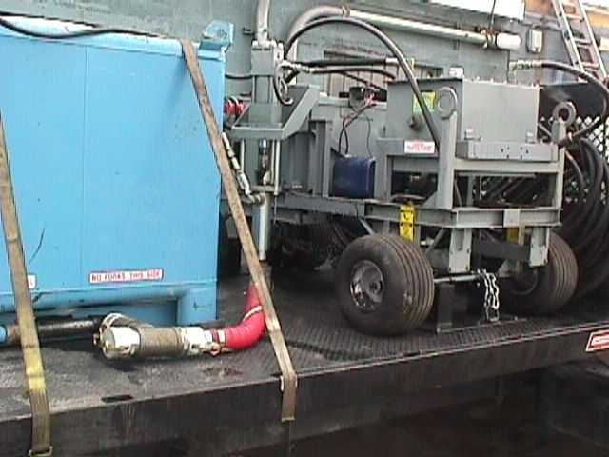
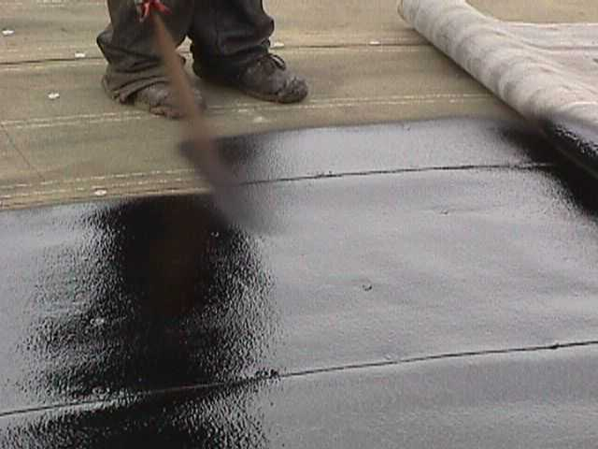
Cold Adhesive Spray

Slide 35
Multi-Purpose MB Cold Adhesive Applications
Apply Firestone Multi-Purpose MB Cold Adhesive at a rate of 1-1/2 to 2-1/2 gallons per 100 ft2
Fold the cap sheet into the adhesive and broom into place. Adhesive should not be left open more than 10 minutes prior to installing the sheet.
Cap sheet application can be completed by applying cold adhesive to the bottom surface of the side and end laps to be mated, or by heat fusing with a propane torch or an automatic heat welder.
Adhesive Temperature must be above 65ºF prior to pumping
Minimum Pump Requirements = 4,000 p.s.i. @ 5 gallons per minute.
Maintain 95 to 110ºF at point of application
Use ¾ inch ID or larger hose with 50 foot—½ inch ID whip at the end
Avoid siphon type pumps
Spray application

Slide 36
Cold Adhesive
Multi-Purpose MB Cold Adhesive
Horizontal application only
Seams
Vertical Flashing
Target Patches

Slide 37
Cool Adhesive
Multi-Purpose MB Flashing Cement
Vertical or
Horizontal
application

Slide 38
Materials Storage At Job Site
Heat provided by 100 watt light bulb inside storage box

Slide 39
Suggested Application Techniques
Conventional Staggered Roll Roof
A line of rolls are relaxed and installed one at a time
Roll block approach using three man crews
Rolls are applied in blocks of ten, then joined with individual rolls by multiple small crews

Slide 40
Lay out ten rolls overlapped

Slide 41
Starting with top roll, fold back on itself

Slide 42
Fold back the second roll on itself

Slide 51
Spread the adhesive using a notched squeegee or spray at recommended rate

Slide 54
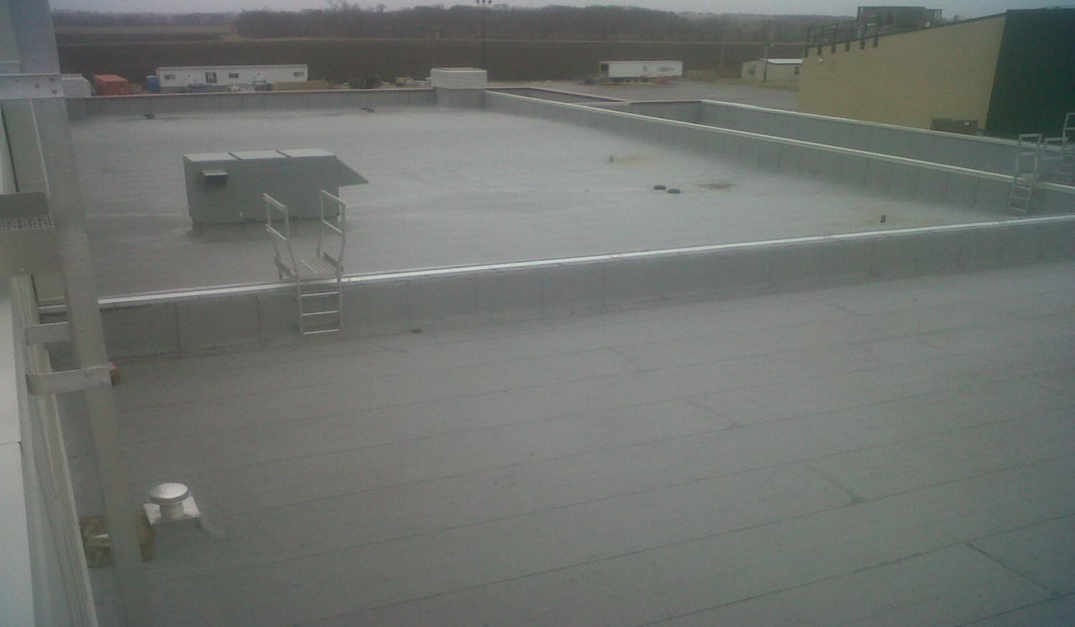
DO

Slide 55
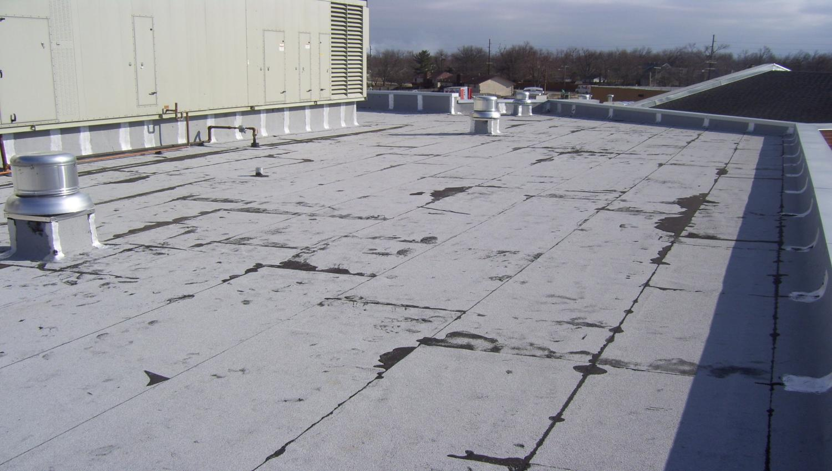
DON’T GRANULES

Slide 56
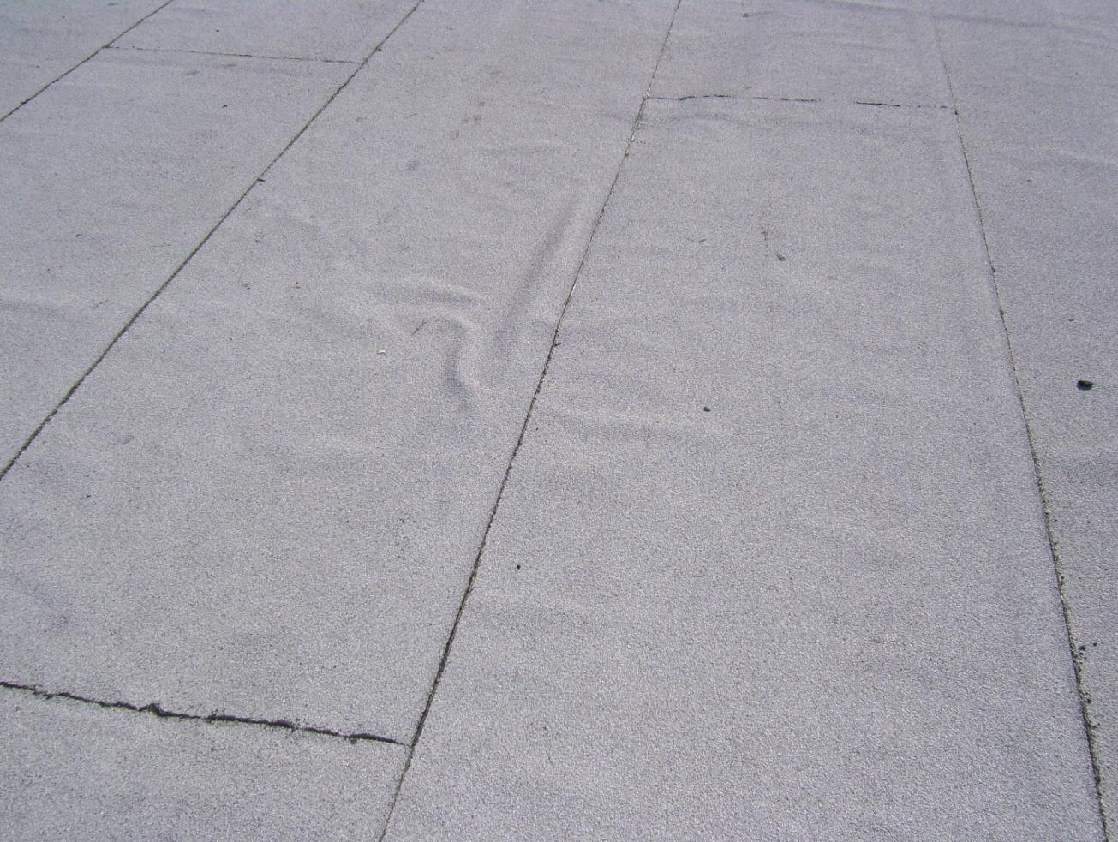
LET THE ROLLS RELAX

Slide 57
FLASHING
SBS
APP
Flashing shall be installed in using APP Cool Membrane and Firestone Multi-Purpose MB Flashing Cement or APP Torch Grade products.
Sheets may be installed in hot asphalt, Multi-Purpose MB Flashing Cement, or by heat welding Torch Grade sheets.
Flashing sections shall be of a size that will not allow cooling of adhesion asphalt before they can be placed into final position
Flashing sections shall be of a size that will not allow cooling of adhesion asphalt before they can be placed into final position
Flashing must extend a minimum of 6” onto the field membrane
Flashing must extend a minimum of 6” onto the field membrane
When torching to a granule surfaced sheet granules must be embedded before the lap is made.
When torching to a granule surfaced sheet granules must be embedded before the lap is made.

Slide 58
SBS “hot” applied wall
Vertical seam and cant mopped also
Asphalt mopped out to sheets edge

Slide 59
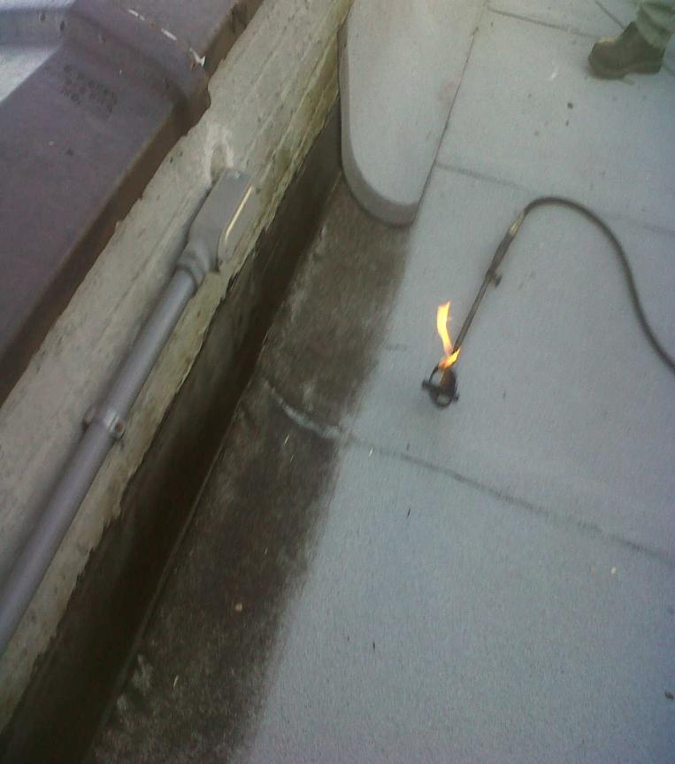
Torch Applied Flashings
Granules Broadcasted in to Bleed out
Granules Embedded Prior to installation

Slide 60
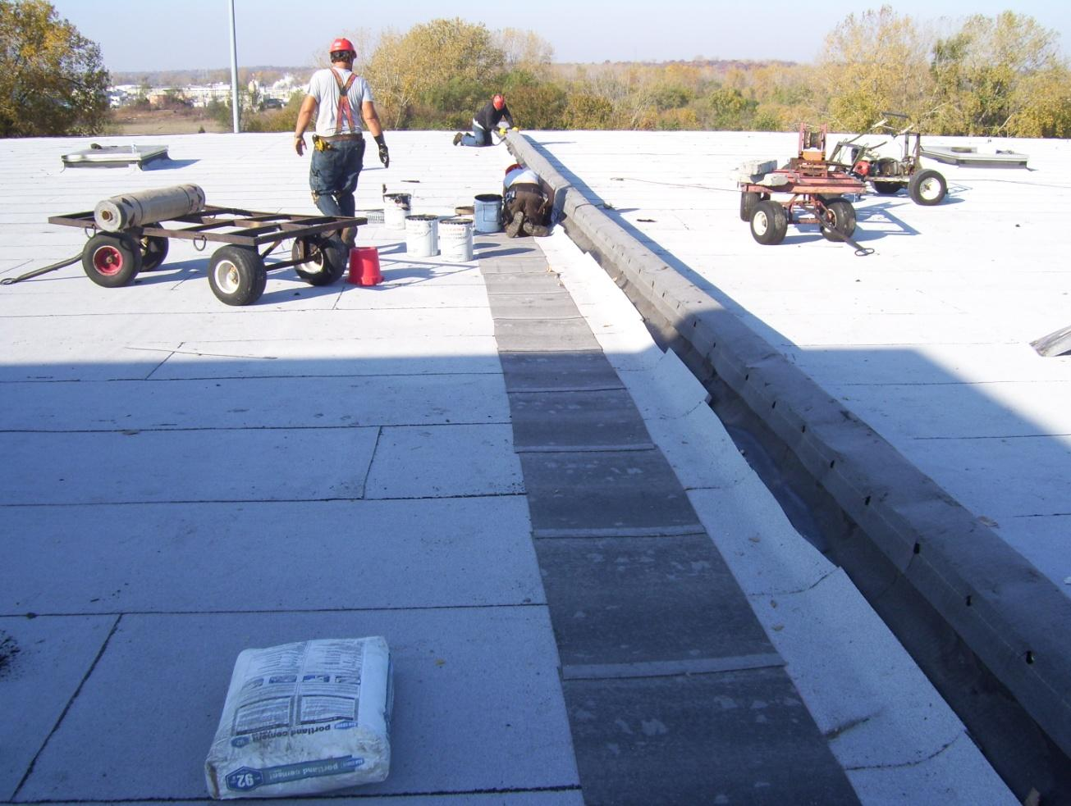
Firestone MB Flashing Cement

Slide 61
DO

Slide 62
Cold Adhesive Application DON’T

Slide 63
DON’T
IF THE FLASHING HEIGHT EXTENDS MORE THAN
24" ABOVE THE FIELD OF THE ROOF CONTACT
FIRESTONE ROOFING SOLUTIONS
Install Flashing in 39” wide pieces and nail off bottom lap 9” O.C.

Slide 64
DON’T
NO CANT INSTALLED

Slide 65
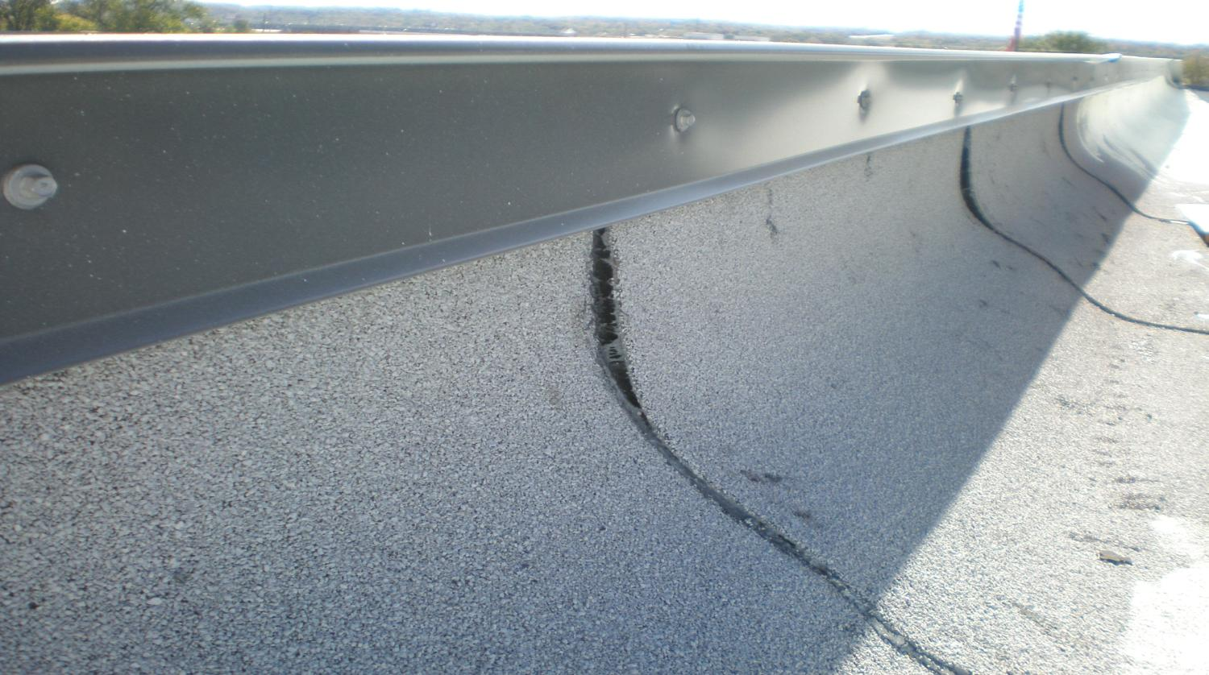
DON’T FORGET THE VERTICAL SEAMS

Slide 66
MB Lap Splice
>Min 6” End Lap & 3” Side Lap
> Bottom Sheet Must Be Cut at A 45*
Granules Must Be Embedded When
Heat Membrane (torch or hot air)
> MB Cold Adhesive/Flashing Cement
can Only Be Use With APP Cool
Or SBS
Refer to All MB-LS Details Online

Slide 67
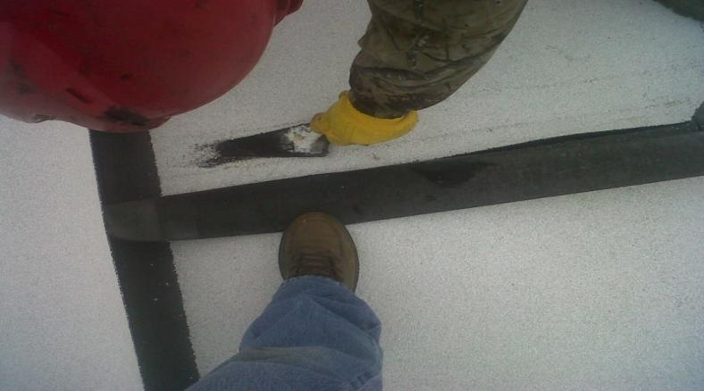
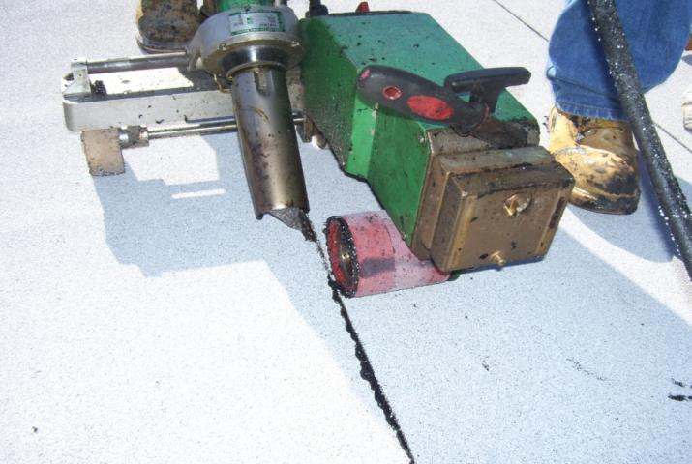
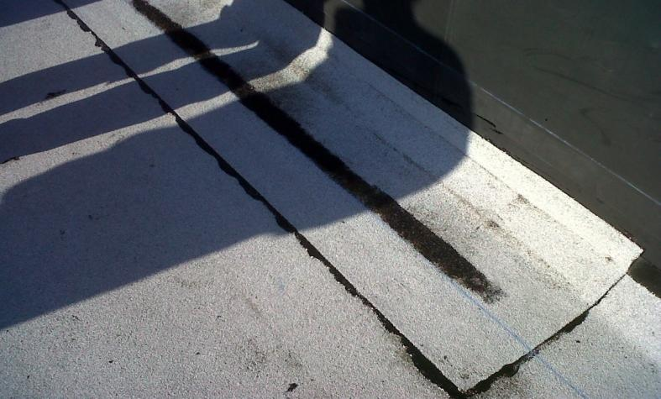
Heat Fused Seams

Slide 68
DON’T
DO NOT OVER COOK
THE SHEETS

Slide 69
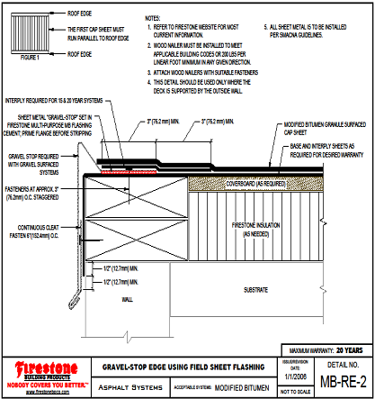
ROOF EDGE WITH FIELD SHEET
Header Sheet Must be Ran Around Perimeter
ALL SHEET Metal is to be Installed PER Firestone or SMACNA Guidelines Whichever is More Stringent
Metal Must Be Primed
INTERPLY REQUIRED FOR 15 & 20 YEAR SYSTEMS
Granules Must be Embedded If Torched or Heat Fused
FASTENERS AT APPROX.
3“ O.C. STAGGERED

Slide 70
MB-ROOF EDGE STRIP FLASHING
ALL SHEET Metal is to be installed per Firestone or SMACNA Guidelines; whichever is more stringent
Metal Must Be Primed
INTERPLY REQUIRED FOR 15 & 20 YEAR SYSTEMS
Granules Must be Embedded If Torched or Heat Fused
FASTENERS AT APPROX.
3“ O.C. STAGGERED

Slide 71
DO

Slide 72
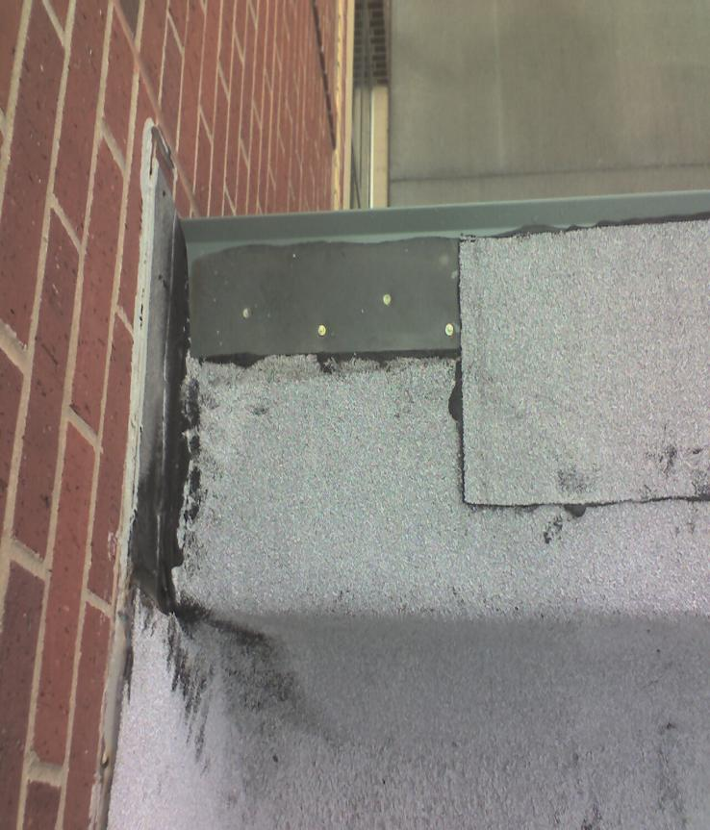
DON’T
NO INTER-PLY
GRANULES NOT EMBEDDED

Slide 73
MB-C-1
Can Be Installed With
Hot Asphalt
Torched (embed granules)
Hot Air (embed granules)
MB Flashing Cement
ULTRA-FLASH

Slide 74
DO

Slide 75
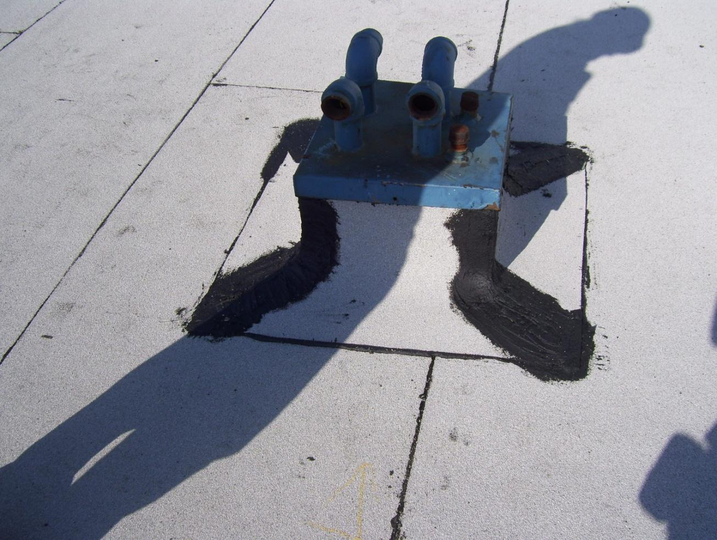
DON’T

Slide 76
MB-C-2

Slide 77
MB-P-1
Metal Must Be Primed
INTER-PLY REQUIRED FOR 15 & 20 YEAR WARRANTIES
Granules Must be Embedded If Torched or Heat Fused

Slide 78
DO

Slide 79
DON’T

Slide 80
DON’T

Slide 81
MB-P-2
Metal Must Be Primed
INTER-PLY REQUIRED FOR 15 & 20 YEAR WARRANTIES
Granules Must be Embedded If Torched or Heat Fused

Slide 82
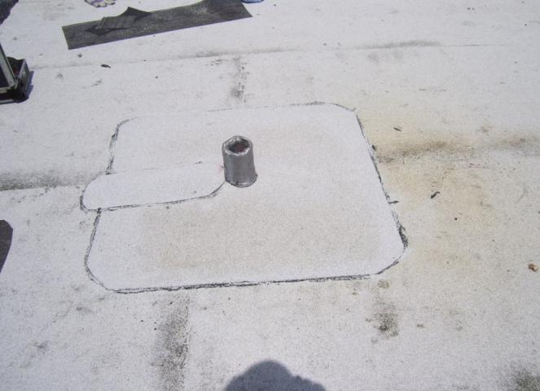
DO
Can Be Installed With
Hot Asphalt
Torched (embed granules)
Hot Air (embed granules)
MB Flashing Cement
ULTRA-FLASH

Slide 83
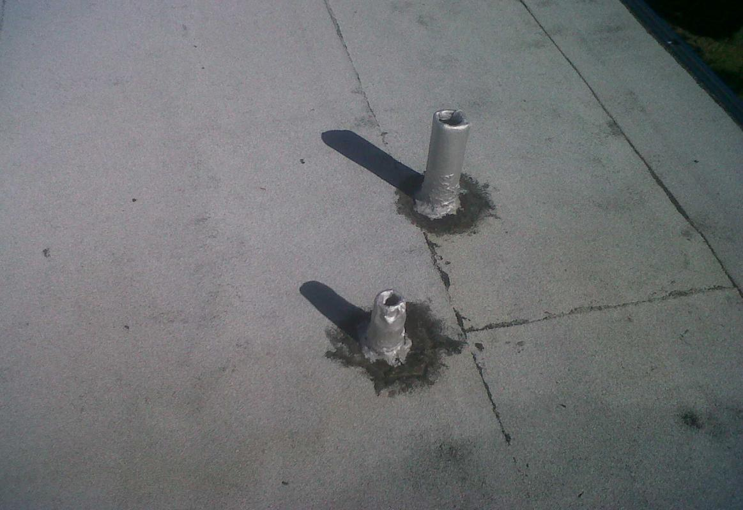
DON’T
Missing inter-ply and target

Slide 84
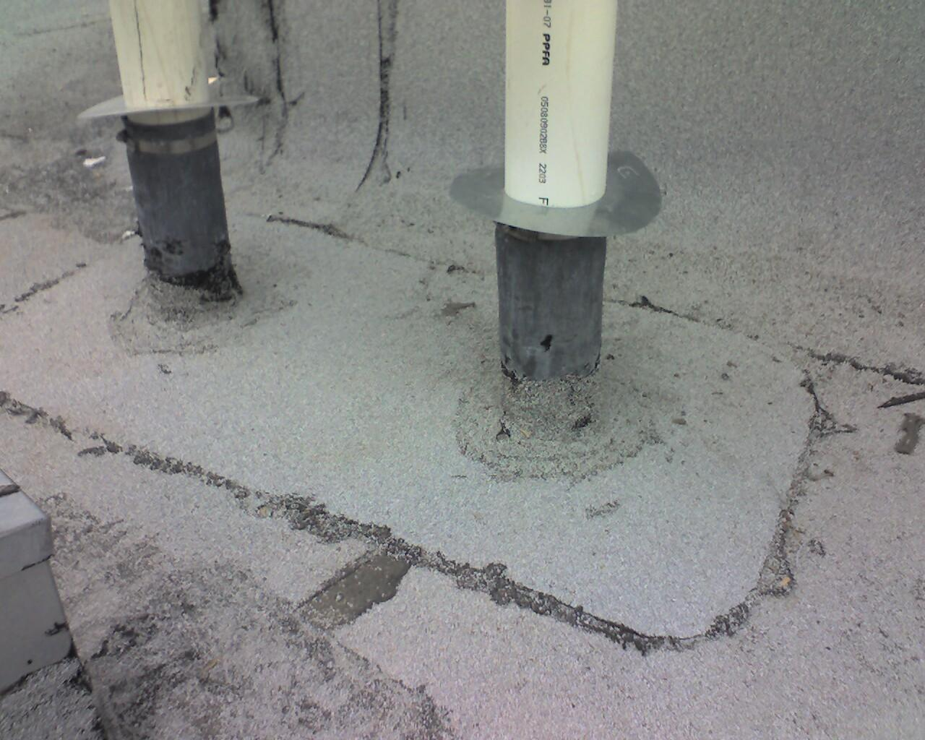
DON’T

Slide 85
PENETRATION POCKET
Metal Must Be Primed
INTER-PLY REQUIRED FOR 15 & 20 YEAR WARRANTIES
Granules Must be Embedded If Torched or Heat Fused

Slide 86
DO

Slide 87
DON’T
NON-FS POURABLE SEALER

Slide 88
DON’T & DON’T
NO ROOF or FLASHING CEMENT FOR FILLER

Slide 89
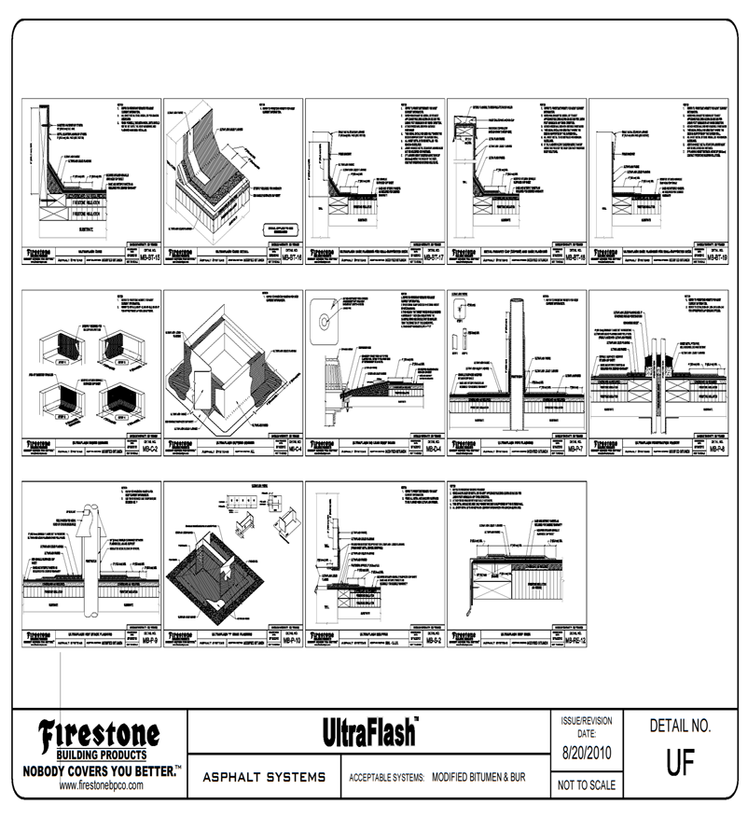
UltraFlash Detail Poster

Slide 90
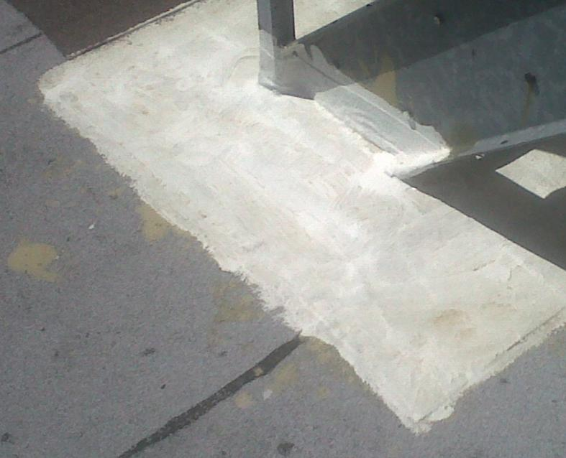
UltraFlash Penetration
Paint With PC100
Or Broadcast Granules
In to the Liquid Flashing
Square Pipes
Outside Corners
Drains
I-Beams
Scuppers
Pipes
Penetration Pockets
And more

Slide 91
Drain Detail
30" SQUARE MINIMUM, 2 1/2 LB. TO 4LB. LEAD OR COPPER
FLASHING SET ON THE BASE PLY IN FIRESTONE MULTI-PURPOSE MB FLASHING CEMENT.
(PRIME TOP SURFACE BEFORE STRIPPING.)
FIELD SHEET LAPS CAN NOT GO INTO A DRAIN RING
NO SEAM CAN BE WITHIN 6" OF THE CLAMPING RING
IF FIELD SEAM IS WITHIN 9” OF DRAIN
COMPRESSION RING, A SMOOTH MODIFIED BITUMEN TARGET PATCH IS REQUIRED
INTERPLY REQUIRED FOR 15 & 20 YEAR SYSTEMS

Slide 92
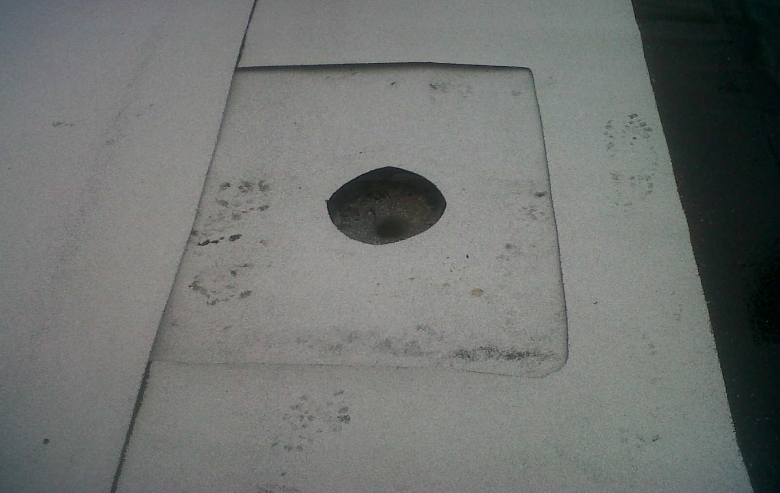
DO

Slide 93
DONT

Slide 94
DON’T

Slide 95
SCUPPER
ALL SHEET Metal is to be Installed per Firestone or SMACNA Guidelines; whichever is more stringent
Metal Must Be Primed
INTERPLY REQUIRED FOR 15 & 20 YEAR SYSTEMS
Granules Must be Embedded If Torched or Heat Fused
FASTENERS AT APPROX.
3“ O.C. STAGGERED

Slide 96
DON’T

Slide 97
DON’T
Scupper flange not installed on top of wall flashing
Metal not primed

Slide 98
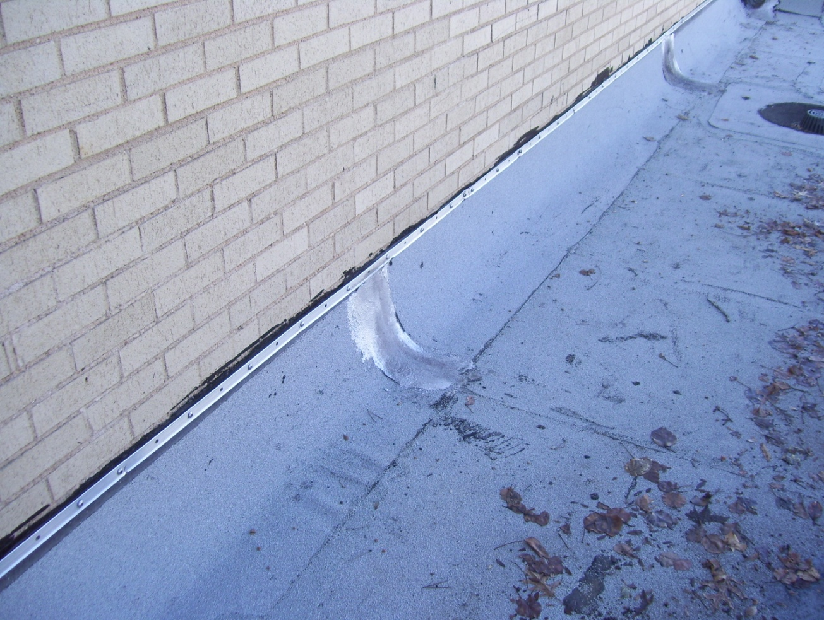
ALL T-BAR MUST BE COVERED WITH COUNTERFLASHING

Slide 99
SA Basics
Starting at the low point of the roof, unroll Firestone MB Base SA and allow the sheet to relax
Begin the attachment by removing the first half of the release paper backing from the membrane.
3. Apply pressure to the top side of the exposed area, starting at the center and working out to the edges, to ensure continuous attachment to the substrate
3. Remove the remaining release-backing from the Firestone SA Base, keeping the membrane in contact with substrate and applying continuous pressure to the top of the sheet, from the center out to the edges.
5. Align subsequent rolls, shingling the laps, and maintaining a minimum 3” side lap and a minimum 6” end lap and repeat the application
6. Note: Firestone MB Base SA Roofing Systems require a heat fused (torched) cap sheet or insulation adhered in I.S.O. Twin Pack.

Slide 100
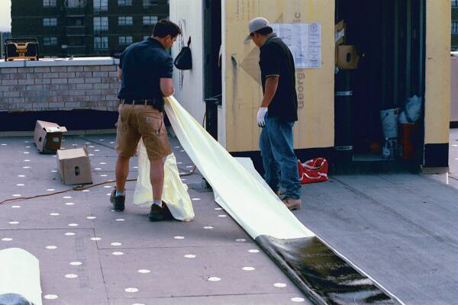
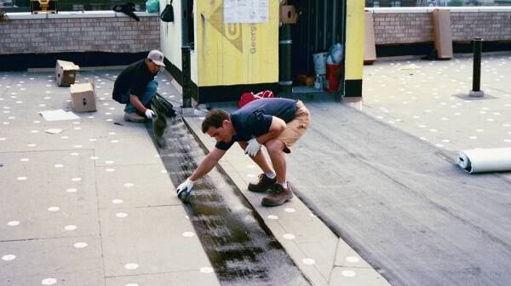
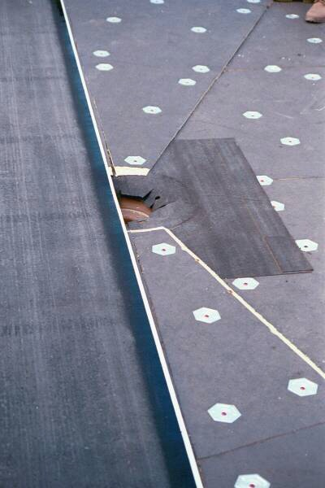
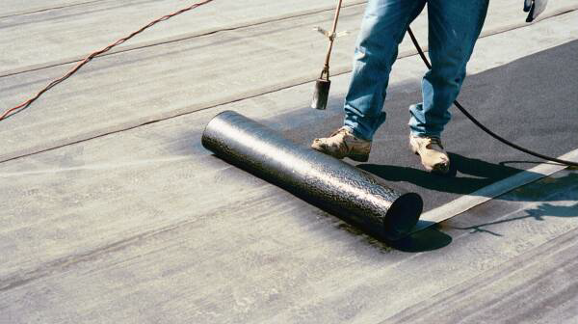
Self Adhered

Slide 101
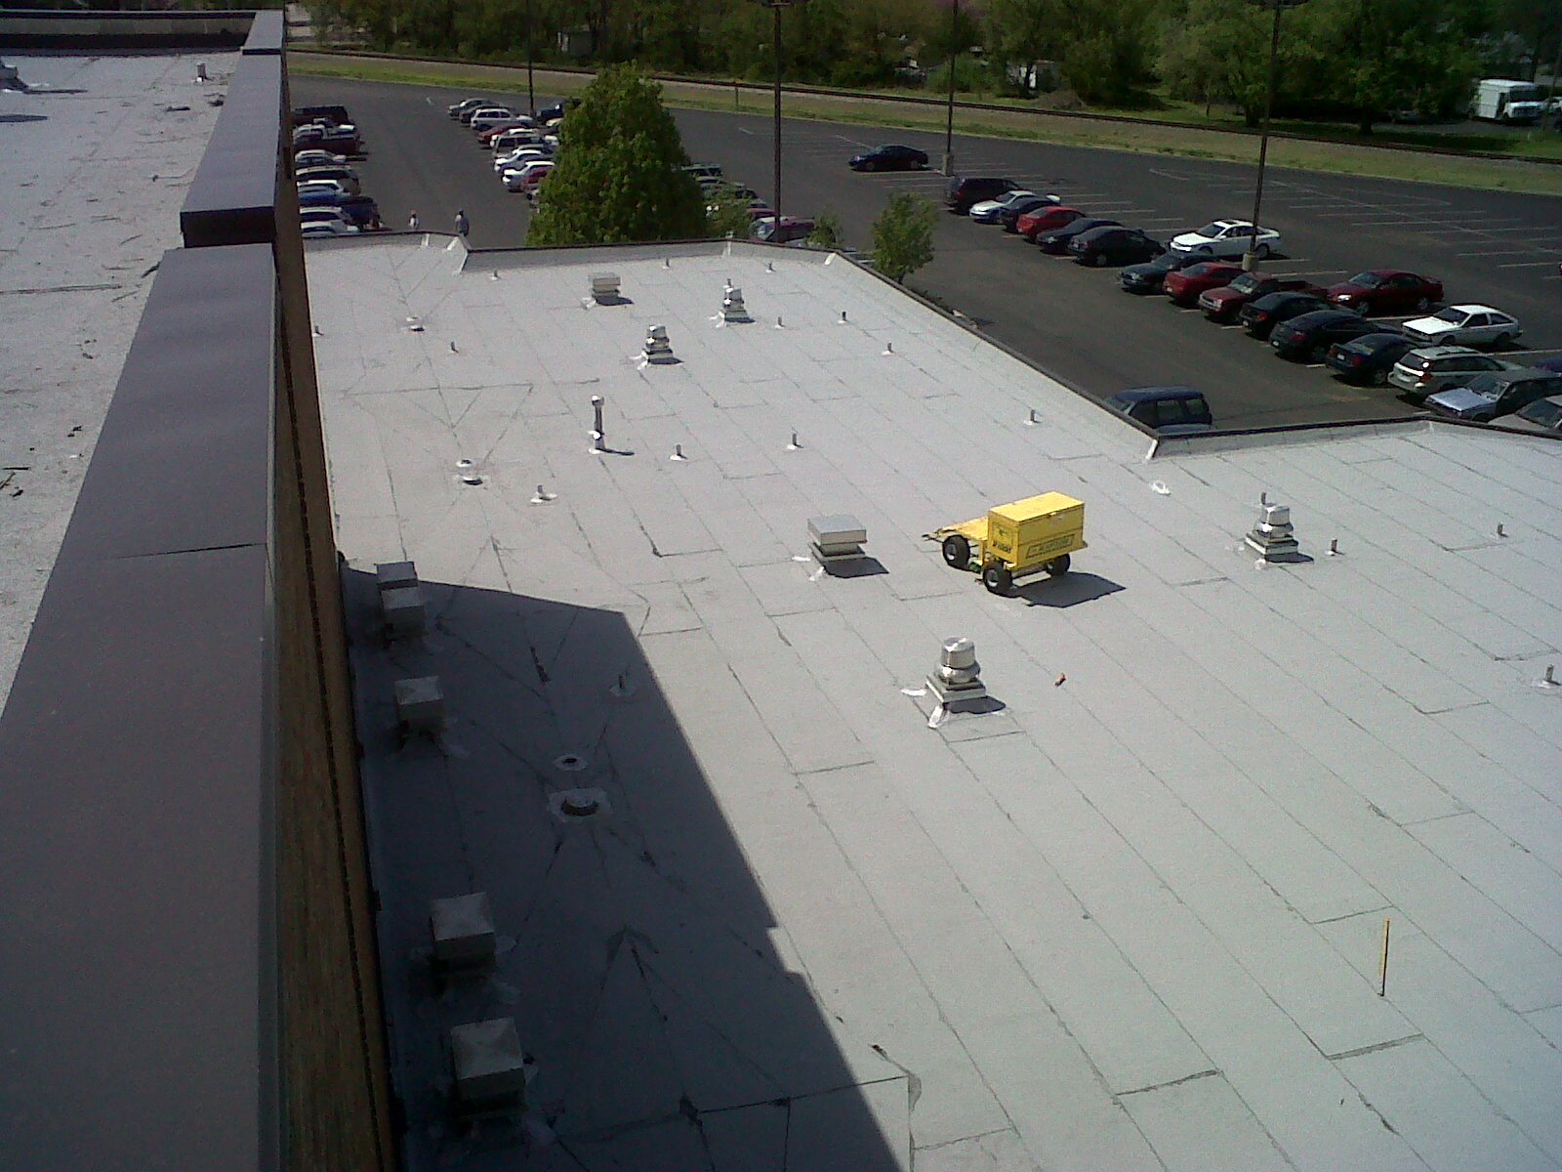

Slide 102
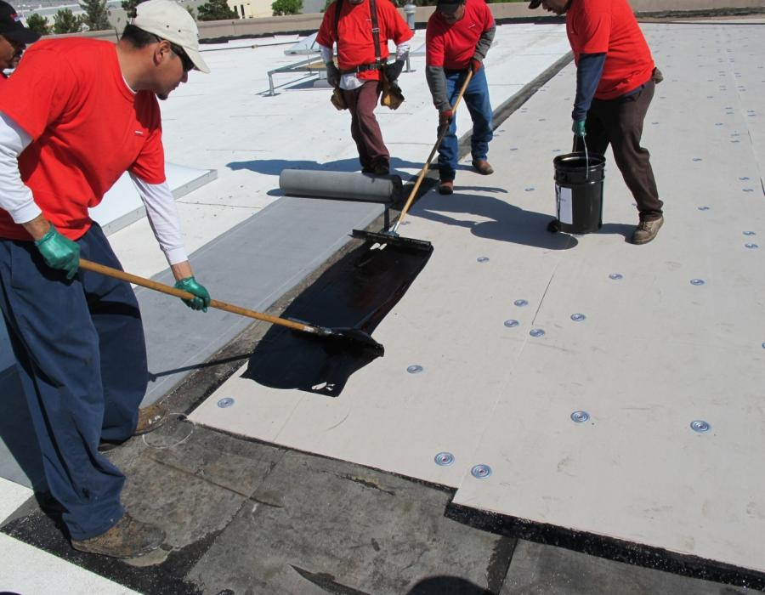
LiquiGard™
Firestone Building Products

Slide 103
LiquiGard™
About
Firestone LiquiGard™ is a tough, liquid applied, two-part polyurethane adhesive. It forms a superior bond with approved Firestone insulation and with SBS and BUR products.
Great for bonding multiple layers of membrane and approved Firestone insulation.
No Odor and Zero VOC’s makes it great for use on schools, hospitals, and occupied buildings.
LiquiGard™ Part B activator is an amber colored liquid component which initiates a chemical cure when blended with LiquiGard™ Part A. This is not a catalyst and must be mixed in proper ratios.
For use with Firestone SBS Modified Bitumen, BUR and Polyiso roofing systems. Application is recommended for membrane attachment to both horizontal and vertical surfaces.
LiquiGard™ adheres aggressively to concrete, steel, Firestone polyiso, other approved insulations and most construction materials. Surfaces must be clean and dry.

Slide 104
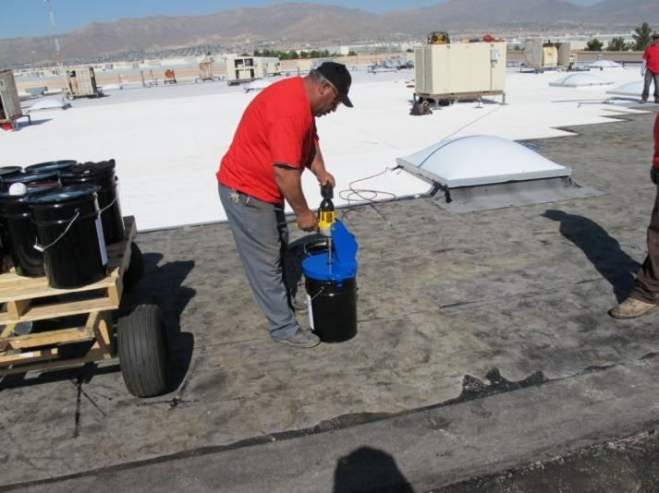
LiquiGard™
Mixing
Mix Part A and Part B with an 8” mud blade for a minimum of 3 minutes.
Do not mix partial containers.
Do not mix by hand.
LiquiGard™ should be at least 60°F when mixed and applied.

Slide 105
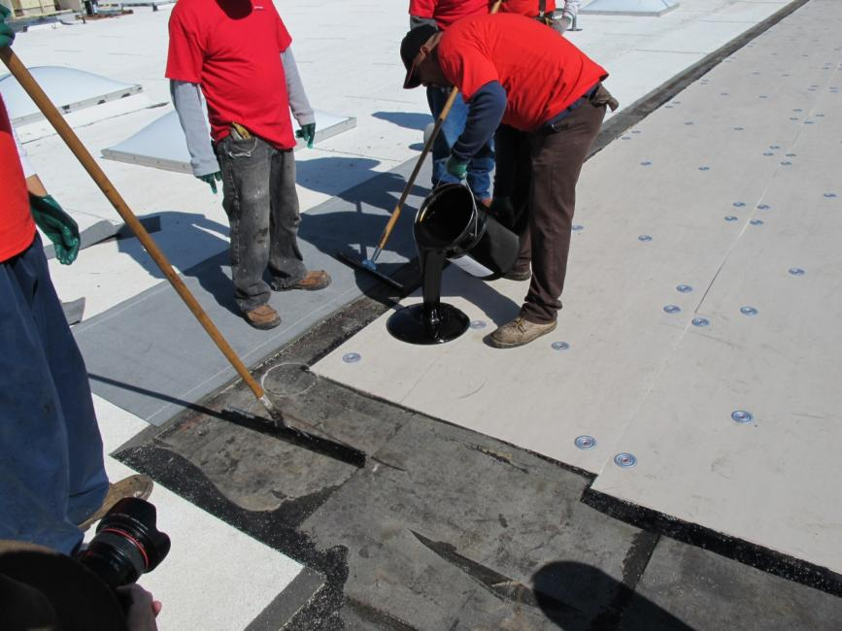
LiquiGard™
Application
Ensure that substrates are clean, dry, smooth, and free of sharp edges or other contaminants.
Ambient and substrate temperatures during application should be 45° and rising.
All material should be applied within 30 minutes after mixing. Warmer temperatures reduce the working time.

Slide 106
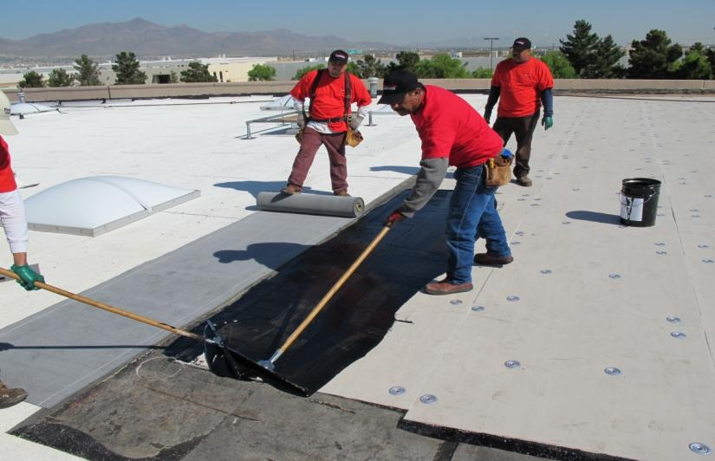
LiquiGard™
Application
For membranes, apply LiquiGard™ in full coverage using a ¼” notched squeegee. Trowels can be used for adhering flashings and other small applications.
Polyiso insulation is adhered in a continuous layer of LiquiGard™.

Slide 107
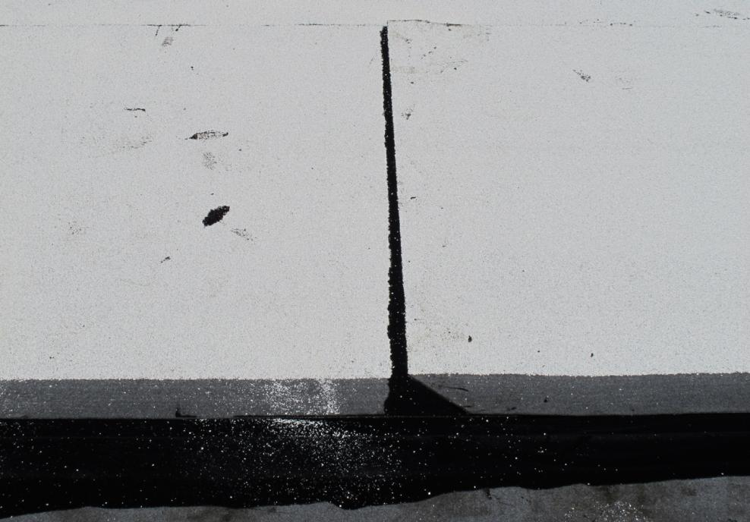
LiquiGard™
Application
Allow for some bleed out at the side and end laps to ensure that the laps are properly sealed.

Slide 108
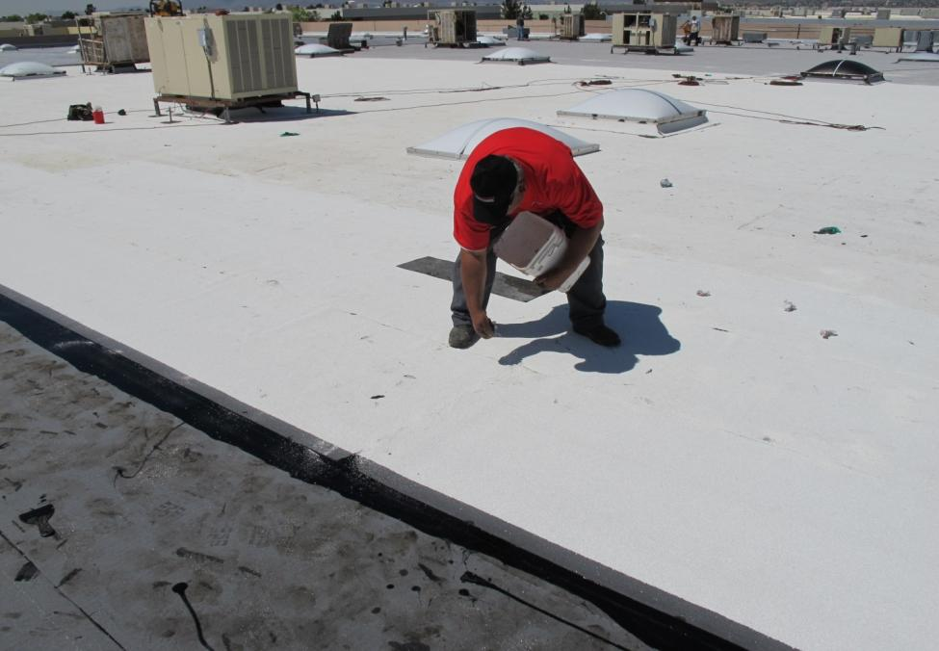
LiquiGard™
Application
Casting granules into the exposed LiquiGard™ is an option that offers a clean, finished look.

Slide 109
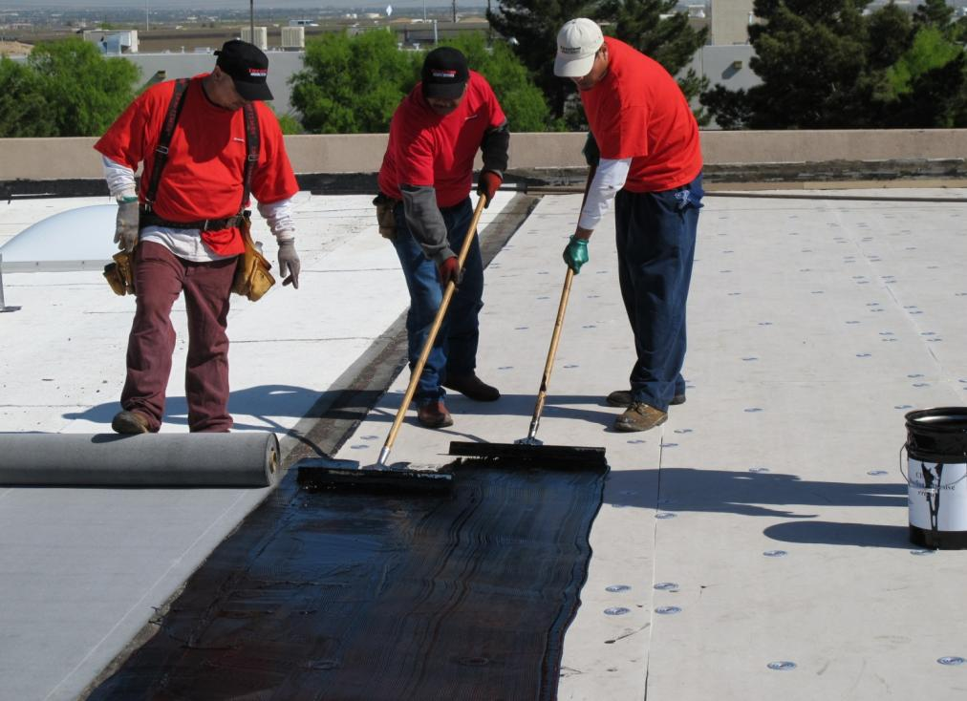
LiquiGard™
For more technical information and updates regarding LiquiGard™ Adhesive visit www.firestonebpco.com

Slide 110
Questions?

