Slide 1

Welcome

Slide 2
Firestone Building Products
Founded in 1982
Leader in low-sloped commercial products
  EPDM, Asphalt & TPO membranes
  Polyisocyanurate & other insulations
  Fasteners
  Accessories
  2 billion Square feet roofing annual sales
  50 billion Sq. Ft. under warranty currently
1 in 4 Low-sloped roofs has Firestone products on it.
Acquired Copper Sales, UNA-CLAD, spring 2005

Slide 3
Metal Roof Basics
Roof types
Base metal types
Panel Coatings

Slide 4
Metal Roof Systems
Through Fastened
Architectural Panel Systems
  Flat-Lock clip systems
  Standing Seam - water shedding
Structural Panel Systems
  Double-lock, Trapezoid, Insulated structural

Slide 5
Through Fastened Roof System

Slide 6
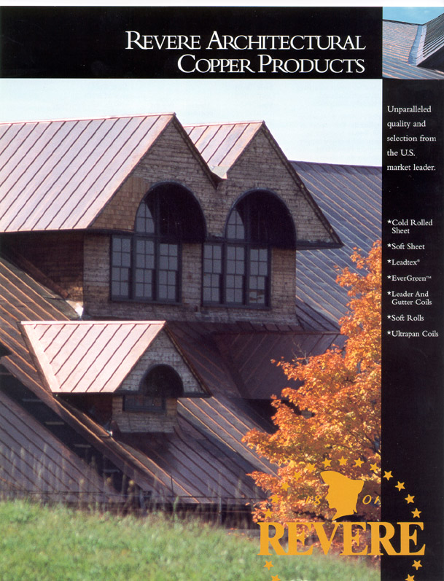

Slide 7
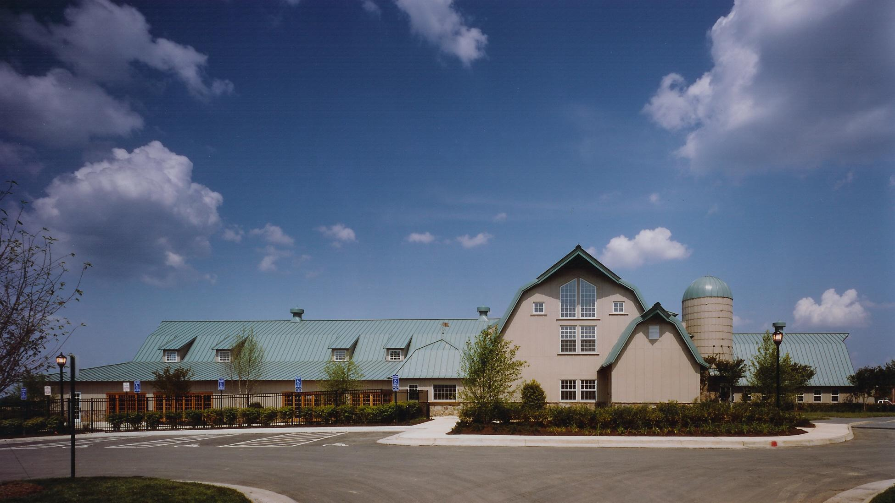

Slide 8
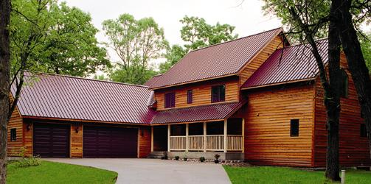

Slide 9

May need to practice before attempting one of these!!!

Slide 10
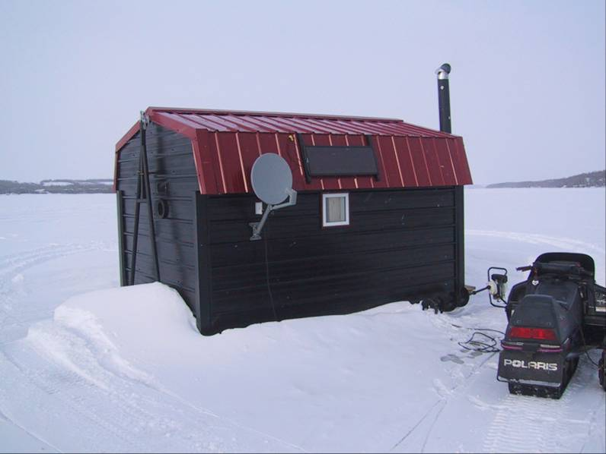
Never underestimate the usefulness of Metal Roofing!!!

Slide 11
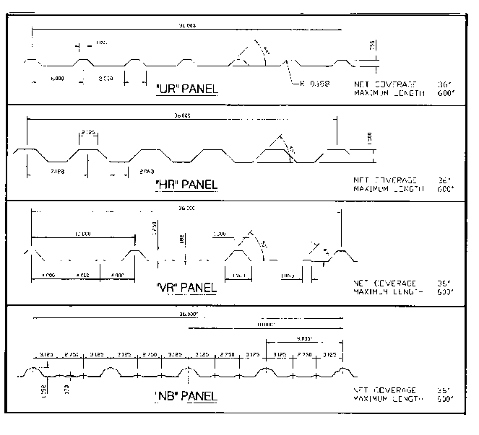
Through Fastened Roof System
Simple Installations
Corrugated Panel
Fast installation
Exposed Fasteners
Omega series offered by Firestone

Slide 12
Architectural Roof Systems
Hydrokinetic (water shedding)
Steep Roof Slope (minimum 3”/12”)
Requires Substrate (non-load bearing)
Concealed Panel Clips Provide Attachment
Minimum Exposed Fasteners
Additional Waterproofing Required

Slide 13
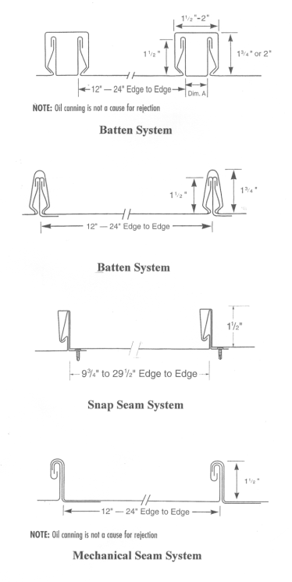
Architectural Panel Systems
Flat-Lock Systems:
  Independent Panel Clips
Standing Seam Systems:
  Independent Panel Caps
  Can Be Radiused
Integral Seam Systems:
  Simple Installation
  No Seamer Required
Mechanical Seam:
  Single & Double Fold Seams
  Requires Mechanical Seamer
  Can Be Radiused

Slide 14
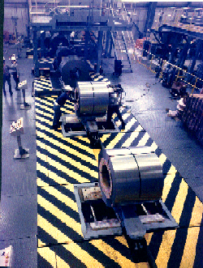
Base Metal for Roof Panels
Copper
RHEINZINK
Aluminum
Stainless Steel
Steel
Acrylume

Slide 15
Base Metal for Roof Panels
Copper
    Old world charm and durability
    Low maintenance
    Water shedding/non-structural applications
    Ideal for coastal environment
Aluminum
    Water shedding/non-structural applications
    Anodic or Kynar coatings required for aesthetics & durability
    Superior for coastal environment

Slide 16
Base Metal for Roof Panels
Stainless Steel
    Very durable
    Optional coating for aesthetics (Terne, Lead coat)
    Limited roofing manufacturers, cost prohibitive for use as a roofing material.
Steel
    Most common material used for architectural and structural systems
    Offered in variety of coatings
    Panel durability is dependent on substrate used

Slide 17
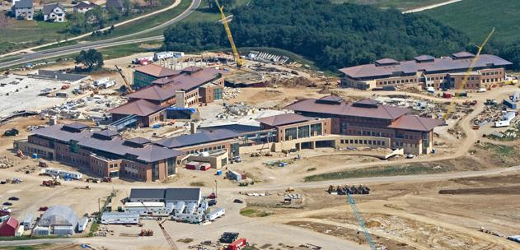
Copper – The “Original” Metal
Notes:
The Epic Campus – Phase One – 250,000 square feet of copper applied by a Firestone Contractor – Interstate Roofing.
Phase II will feature Freedom Gray Copper by Revere Copper through FSMP/UnaClad.

Slide 18
Copper
The oldest metal of the metals that is still used today.
Very easy to work with (with proper tools).
The best life cycle value.
Easily recycled.
A commodity that is traded on the exchange everyday.
Can be 3-4 times as expensive as coated steel/alum.

Slide 19
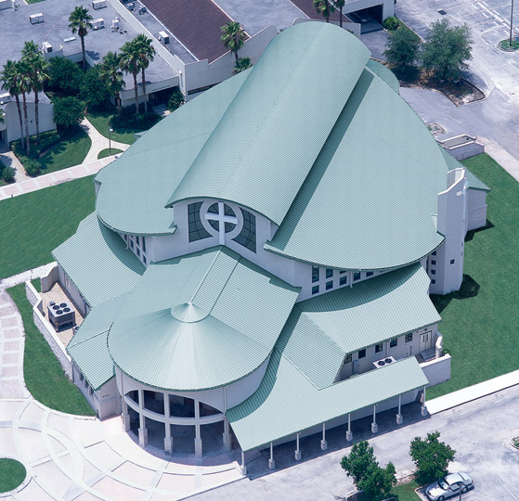
Aluminum
Light weight and non-ferrous are the strengths.
Great life cycle costs
Flatness is the best of all the coatable substrates.
Global presence & availability
Great for Salt regions

Slide 20
Stainless Steel
  Not used a lot in roofing.
  Used in column covers, wall panels, custom projects, decorative, food service areas.
  The two most common are Type 304 and Type 316. The latter has a higher nickel content and thus is the most resistant to rusting.
  There are four predominant (mechanical) finishes.
    #8 Mirror finish
    #6 In line brushed finish
    #4 Standard brush finish
    2B standard mill finish

Slide 21
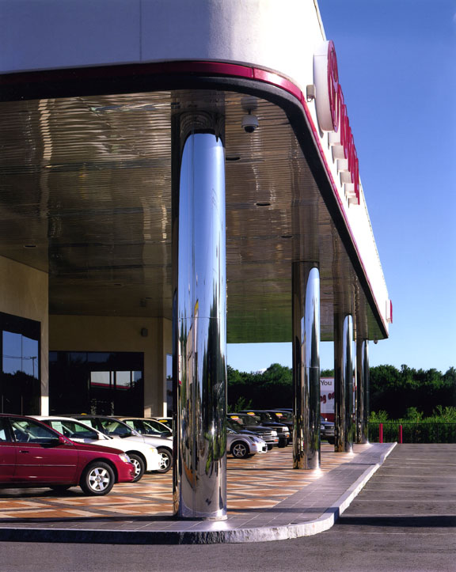
Stainless Steel
This is a good example of designing a truly finished appearance.
The stainless column covers are #8 mirror finish.

Slide 22
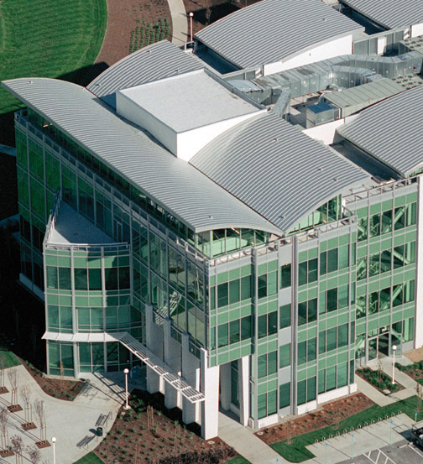
Steel
The most popular material used for roofing.
  It is cost efficient.
  Easy to work with.
  A strong performer.
Galvanized steel and Galvalume are the leaders.

Slide 23
Substrate Coatings
Metallic Coatings
  Galvanized
    Zinc protective coating over base steel ( G-40, G-60, G-90 )
  Galvalume
    Aluminum/zinc protective coating over base steel ( AZ-50, AZ-55 )
  Acrylume
    Clear acrylic coating for unpainted substrate
    Note: Both are trademark names…

Slide 24
Galvanized Steel
Steel strip is hot-dipped in a continuous line.
  The thickness of the zinc coating …
    G90 - .90 ounces per square foot
      48” x 120” sheet = 2.25 lbs of coating wt.
    G60 - .60 ounces per square foot
      48” x 120” sheet = 1.5 lbs. of coating wt.
    G40 - .40 ounces per square foot
      48” x 120” sheet = 1 lbs. of coating wt.
Notes:
Galvanized steel, for our products, are done in a hot dip process. The strip of cold rolled steel is ran through a tank of molten zinc. The strip continues out of the zinc bath, vertically, where air knives are positioned on each side of the the strip and cut the coating to the desired thickness. It then continues through a rinse and then to a recoiler. The thickness that is used on the UnaClad line of painted steel for architectural roofing is G90. I have listed the coating weights and what the coating on a 48” x 120” sheet would weigh. Rest assured that the thinner the coating the shorter the life span of the product and the cheaper it is to manufacture.

Slide 25
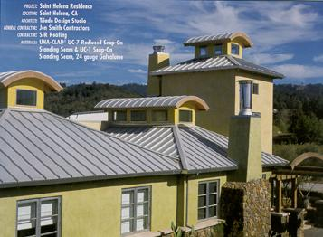
Galvalume
Galvalume sheet steel is an 55% aluminum-43.4% zinc alloy coated sheet steel product that is ideally suited for most types of roofing applications.
Pictured is an application of Acrylume which is acrylic coated Galvalume.
Notes:
Galvalume was made popular by Bethlehem Steel many years ago. They promoted it with a lot of hype, warranties with the intent to add revenue by having a higher prices product. A lot of that promotion and hype still lingers in the architectural community because the steel mills are not allocating any money to be spent there. That makes it easier for us because we become the corporation that the architects will look to for specification guidance and direction.

Slide 26
Galvalume
Steel strip that is hot-dipped in a continuous line.
  The thickness of the zinc coating …
    AZ55 - .55 ounces per square foot
      48” x 120” sheet = 1.375 lbs. of coating wt.
    AZ50 - .50 ounces per square foot
      48” x 120” sheet = 1.25 lbs. of coating wt.
Notes:
A note to remember here is that many of the companies that promote painted Galvalume do so using an AZ50 coating. One of the reasons is that it is easier to control the smoothness of the surface. Keep in mind, the paint is the barrier coat and is there to protect the substrate. The AZ50 is less expensive than the AZ55.

Slide 27
Who’s Best?
Galvalume versus Galvanized
  Application many times drives the decision
    E.g. You can not use Galvalume around animal confinement.
    Both are the wrong selection for true performance in a salt water environment. The correct substrate for a salt water environment is aluminum.
  In reality both galvanized and galvalume are long lasting products and a good selection for an exterior of a project in most conditions. (Salt water being the exclusion for both.)

Slide 28
Acrylume
    For unpainted applications, bare Acrylume is recommended.
    It has a clear “Acrylic” resin coating applied to both sides of the steel sheet.
    Can be roll-formed without lubricants.
    The clear coating prevents blackening from finger prints and oil spots.
    The clear coating will dissipate and allow the Acrylume to age to a soft gray uniform appearance.
Notes:
A very popular product is some regions in the country. A lot of the popularity is from the color and some because it is less expensive than painted Galvalume or Galvanized.

Slide 29
Rheinzink
We have developed a relationship with Rheinzink, the market and industry leader.
  A German mill that is known for producing the best zinc product world wide.
  A European leader that selected UNA-CLAD to bring their product to market in the United States and some parts of Canada.
  Firestone is Rheinzink’s largest distributor.
  U.S. Warehouse opened about a year ago in the Boston area.

Slide 30
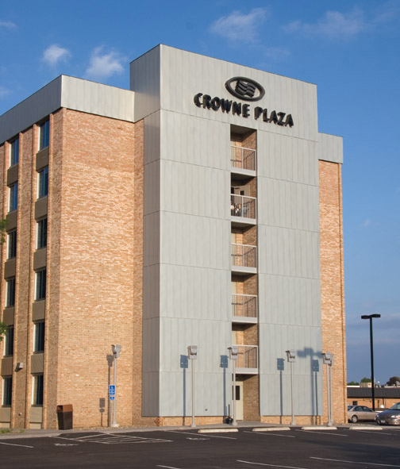
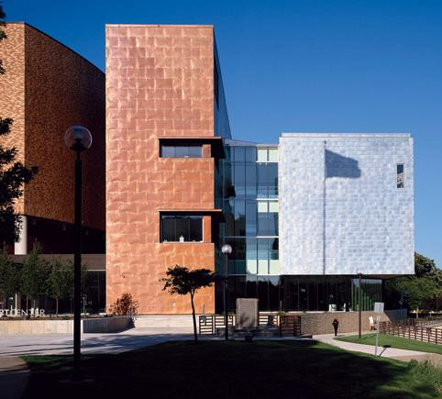
Rheinzink

Slide 31
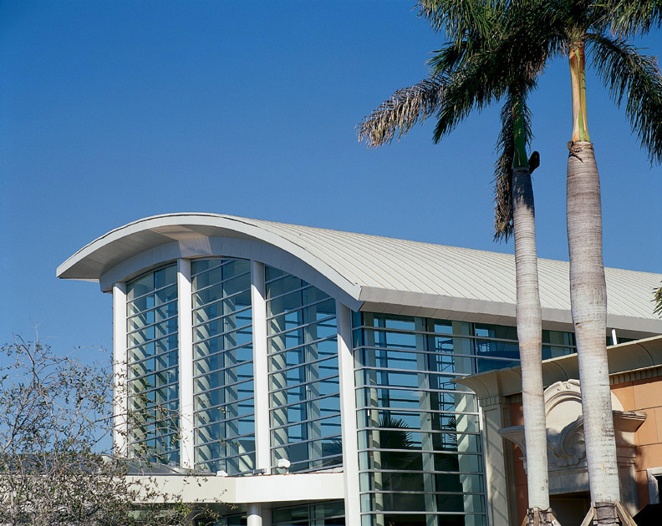

Slide 32
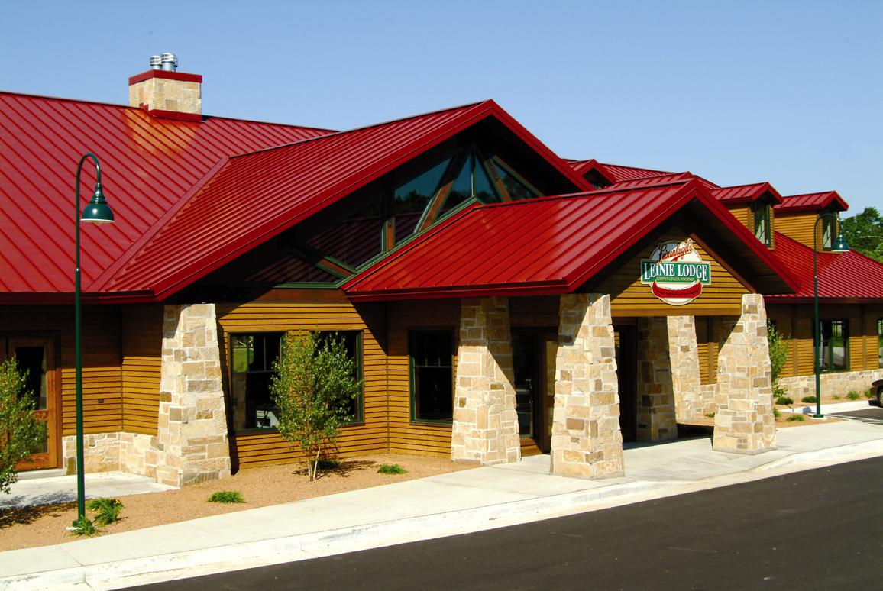

Slide 33
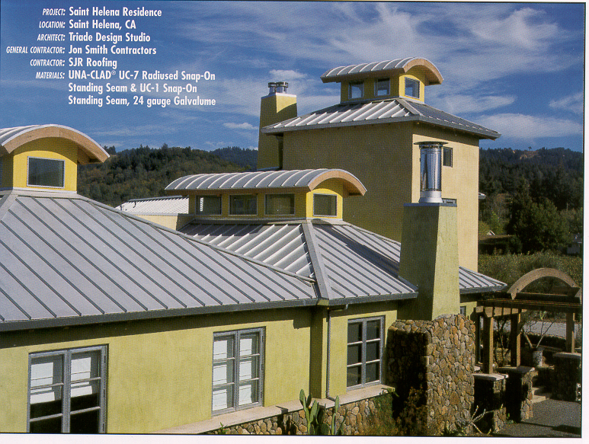

Slide 34
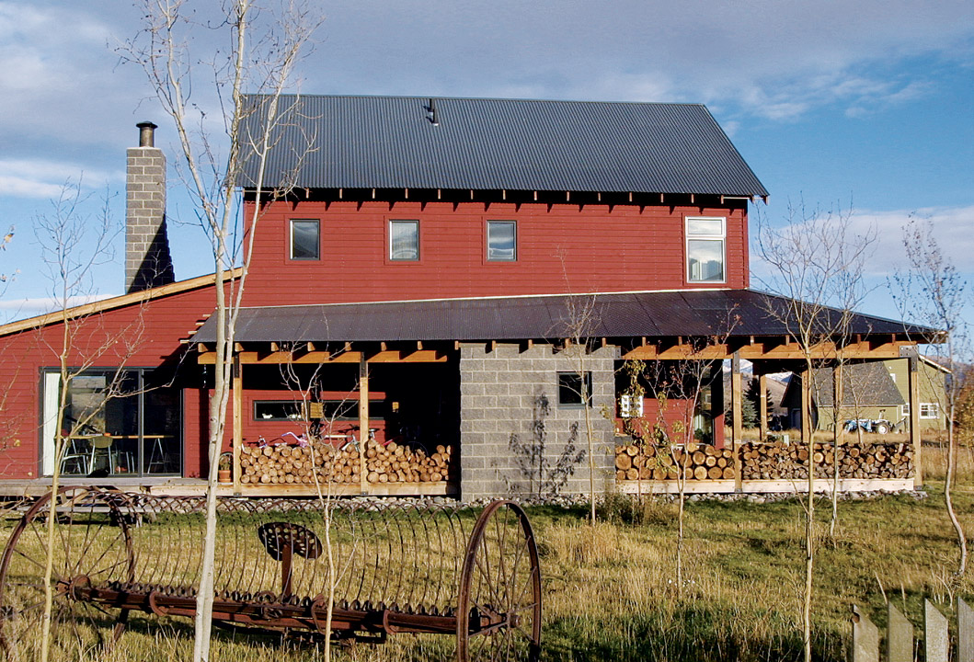

Slide 35
Two Primary Alloys
3000 Series – Used for painted coatings
Are alloyed with manganese, and can be work- hardened
5000 Series – Used for anodized finishes.
  Are alloyed with magnesium, derive most of their strength from work hardening. However is susceptible to corrosion above 60°C, 140°F.

Slide 36

Why Do We Paint?
Provide protection
Add aesthetic appeal
Promote corporate
brand and increase recognition
Decrease energy costs

Slide 37
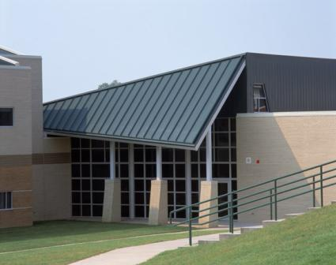
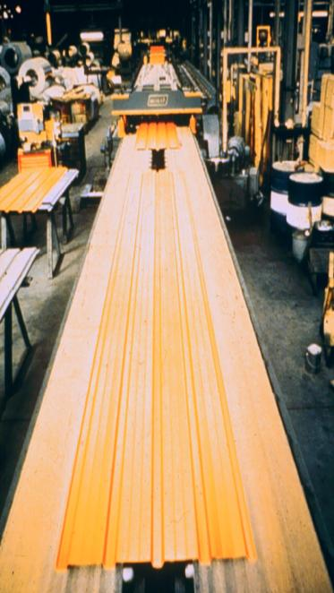
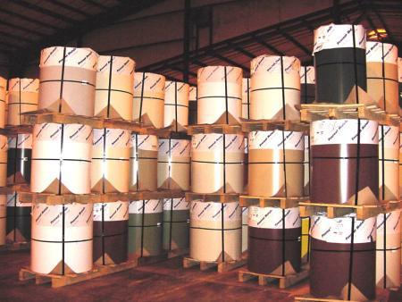
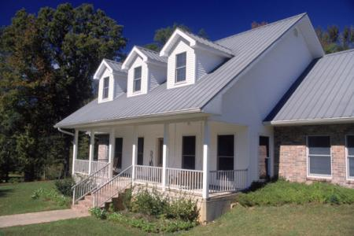
From Coil to Building

Slide 38
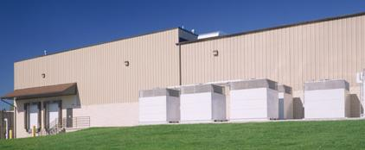
End Uses
Wall panels
Roofing panels
Component parts
Pre-engineered buildings
Agricultural buildings

Slide 39
Fluoropolymers (Teflon)
A fluoropolymer is a fluorocarbon based polymer with multiple strong carbon–fluorine bonds. It is characterized by a high resistance to solvents, acids, and bases.
Excellent resistance to chalk and fade
Excellent chemical resistance
Excellent post-formability
Excellent gloss retention
Excellent humidity resistance
Wide range of colors available

Slide 40
Conclusion
Paint is comprised of pigments, resins, solvents, and additives.
The quality of the paint ingredients and chemical technology are key to product performance.
The best choice of paint coating depends upon a variety of factors including end use, color and gloss desired, budget, product life-cycle, and environment.

Slide 41
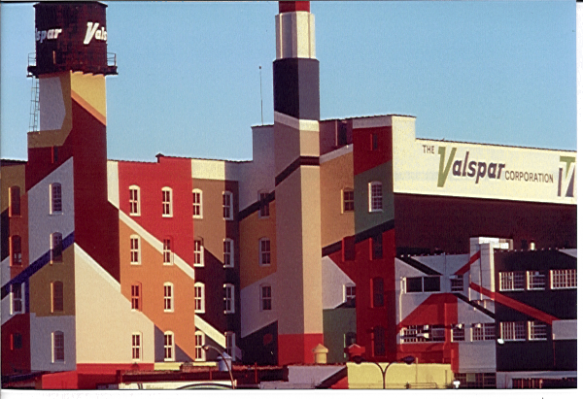
The Valspar Corporation
Founded in 1806
Celebrating 200 years
Headquartered in Minneapolis, MN
Worlds largest
non-automotive coatings company
  6th in world
  3rd in USA
Corporate Headquarters
Notes:
Valspar was founded in Boston back in 1806. Our first product was Spar Varnish designed for Clipper Ships. We’ve grown quite a bit in the last 200 years.

Slide 42
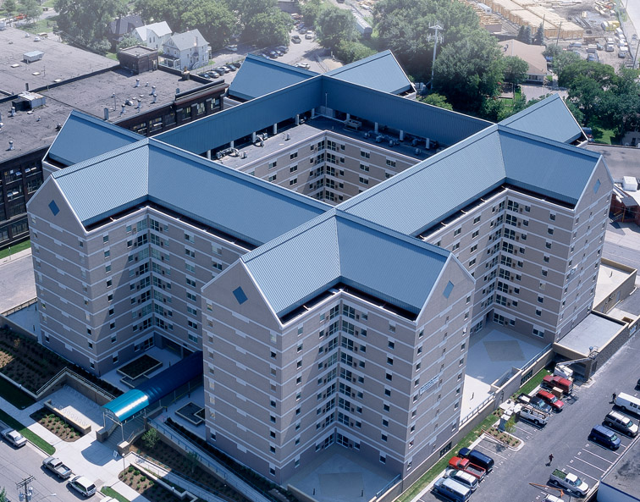

Slide 43
UNDERLAYMENTS
Self-adhered membrane
ASTM D 1970 for nail sealability.
May be left exposed for 60 days or more.
Minimum high temperature resistance of 230º F.
Contact FSBP Roof Solutions for Approved Alternates (manufacturers)

Slide 44
Underlayments
Felt/Rosin Paper (non-warranted systems)
Non-Asphaltic Membranes (MA-mechanically
attached)
Self Adhering Membranes (SA-Peel & Stick)
Ventilation Mats (Required for Rheinzink)

Slide 45
CLAD-GARD underlayments
Firestone is proud to present two new underlayments:
  CLAD-GARD SA – a modified SBS self adhering underlayment with a non-skid woven top film
  CLAD-GARD MA – an inorganic coated woven underlayment that is mechanically-attached with cap nails

Slide 46
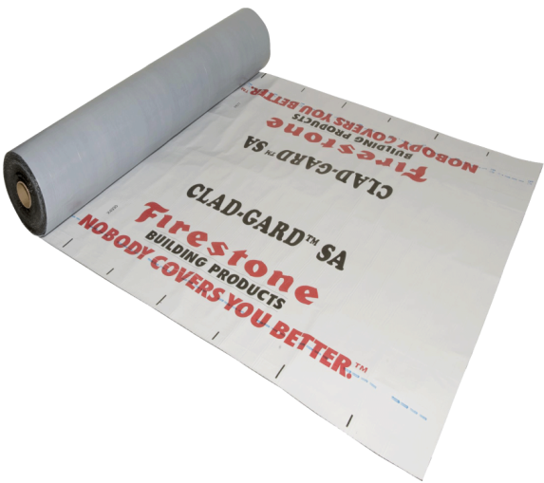
CLAD-GARD SA underlayment
Features:
  Woven non-slip top surface
  Non-reinforced modified SBS
  High-temp resistant
  UV resistant
  Silicon-coated split-release film
  Light-colored reflective surface

Slide 47
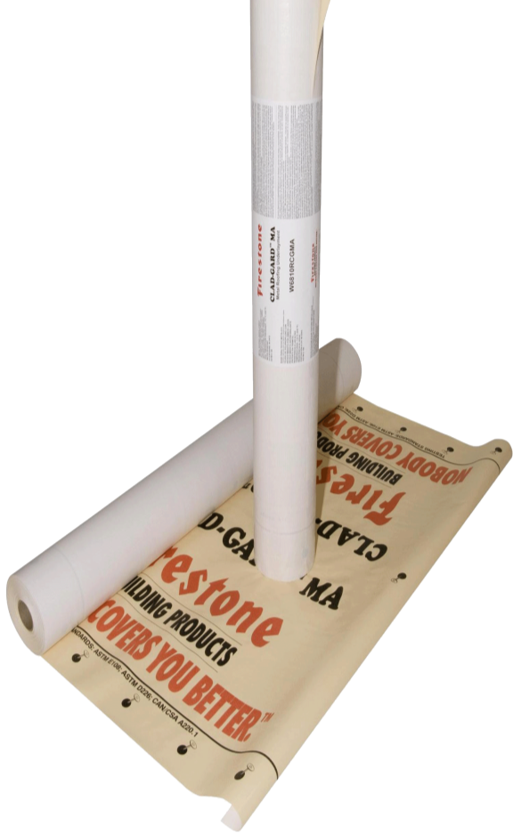
CLAD-GARD MA underlayment
Features:
  Woven top surface is textured and has a rubberized coating
  High-temp resistance to 230° F
  UV resistant
  Light-colored reflective surface
  Light weight
  48” wide x 250’ roll size (10 sq. gross coverage)
  Warranted for slopes 5/12 (+)

Slide 48
CLAD-GARD R Underlayment
Features:
  Styrene-Butadiene-Styrene (SBS) rubber modified
  Self-adhesive membrane.
  Reinforced with a non-woven fiberglass mat.
  Textured, slip-resistant traction film on the top surface and a silicone-treated.
  Split-back opaque release film on the bottom surface.
COMING SOON!

Slide 49
UNA-CLAD Metal Panels

Slide 50
RED SHIELD
WARRANTED SYSTEMS
UC-3 Double Lock
UC-4 Nail Strip, 40 ft max, Unidirectional
UC-6 Tall UC-3
UC-14 Snap Lock w/clip

Slide 51
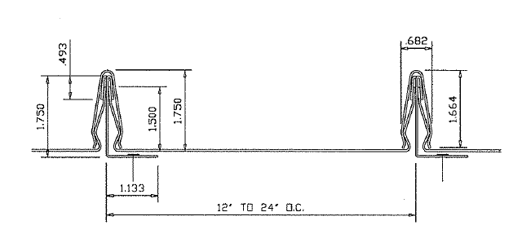
UC-1
Snap-On Standing Seam

Slide 52
Notes:
This home in St Helena, CA features both straight and radiused snap on standing seam panels. The radiused panels have a 1” seam height while the straight panels are 1 ½” high, but the two profiles blend well together because their seams are a similar style. These panels work well on roofs with lots of hips like this roof because they can be installed in both directions and a skilled installer will utilize all of the material by cutting a panel in half and using the other half on an adjacent side of the roof.

Slide 53
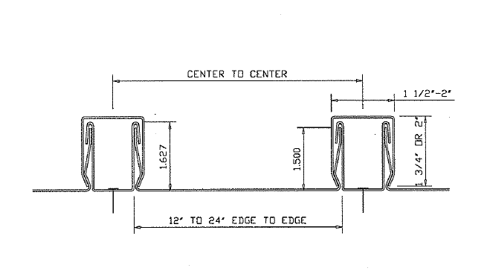
UC-2
Snap-on Batten Seam
UL-580 Class 90

Slide 54
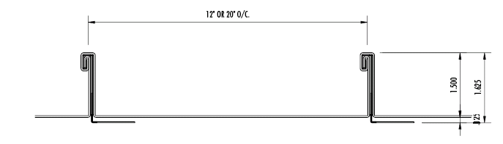
UC-3
Double Lock Standing Seam
UL-580 Class 90
Metro Dade County Approved

Slide 55
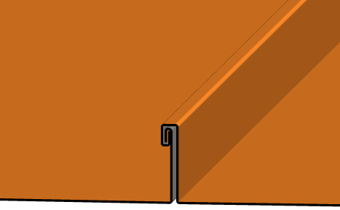

Double-Lock Architectural Series
UC-3
Red Shield Warranty
5, 10, 15, 20

Slide 56
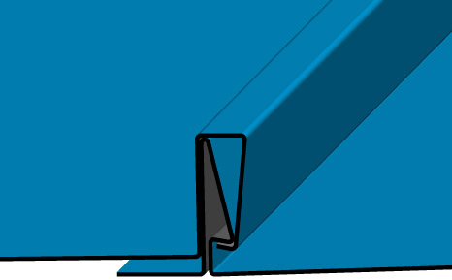
No-Clip Architectural Series
UC-4
Red Shield & 25 Year Red Shield Medallion
5, 10, 15, 20, 25

Slide 57
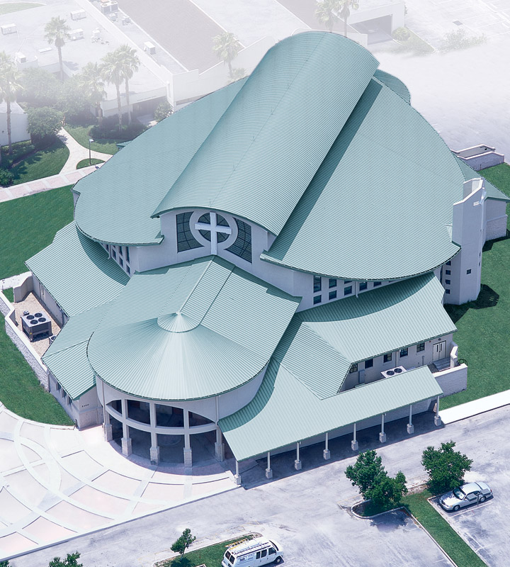
Notes:
St Peter and Paul Catholic Church in Winter Park, FL shows the versatility of the Double lock panel. This project has straight, radiused and tapered panels – all using the same profile. All of the panels on this project were factory roll formed and shipped to the job site.

Slide 58
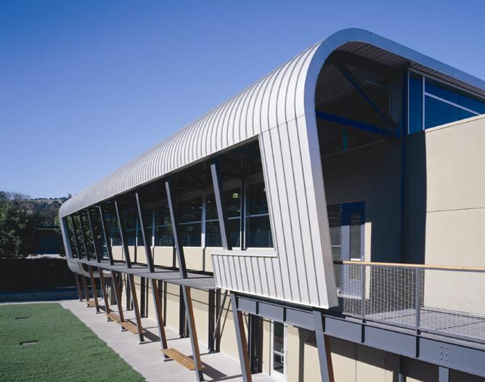
Notes:
This is the Bentley School in Layfayette, CA. This unique design would have been very difficult with other systems because of the tight radius between the roof and wall, but with this type of panel a continuous line is achieved. Notice that the panel is not continuous – it is spliced at the wall and roof.

Slide 59
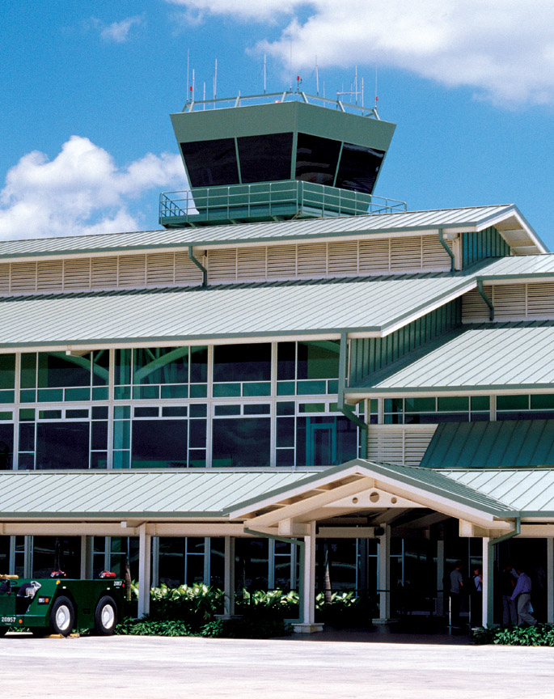
Notes:
Here’s another one… Integral seam panels are an excellent choice for long straight runs, like these, on the La Romana International Airport in the Dominican Republic.

Slide 60
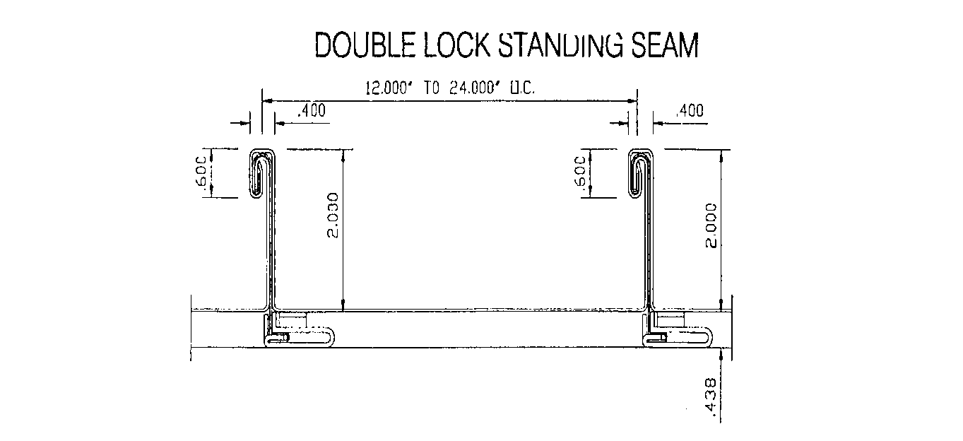
UC-6 Structural Double Lock
Standing Seam
UL-580 Class 90
ASTM 1592
Metro Dade County Approved

Slide 61
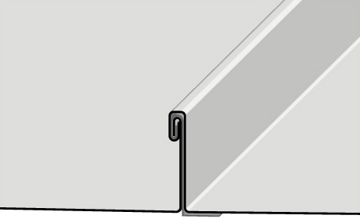

Double-Lock Structural Series
UC-6
Red Shield Warranty
5,10,15,20

Slide 62
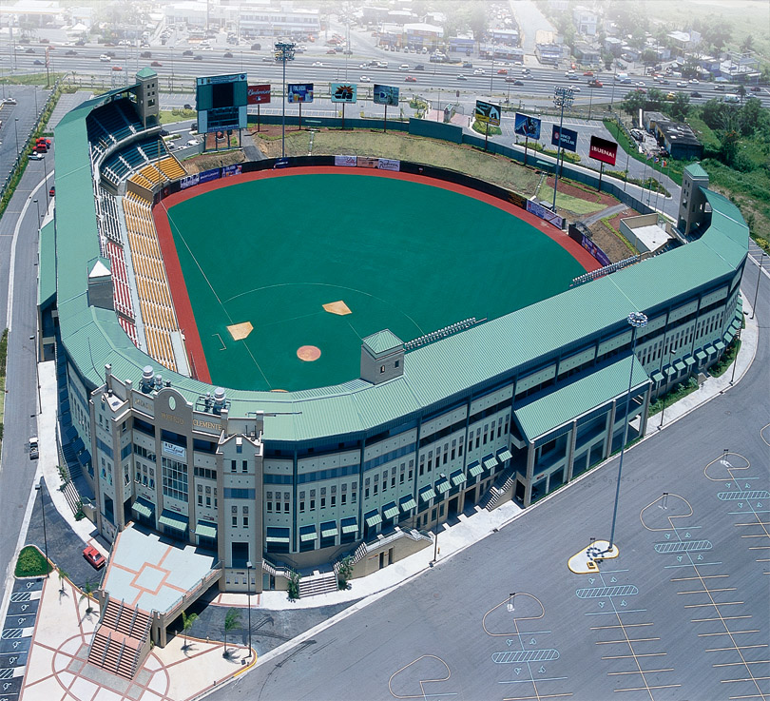
Notes:
Roberto Clemente Stadium in Carolina, Puerto Rico. It is a 24 ga UC-6 Double Lock.

Slide 63
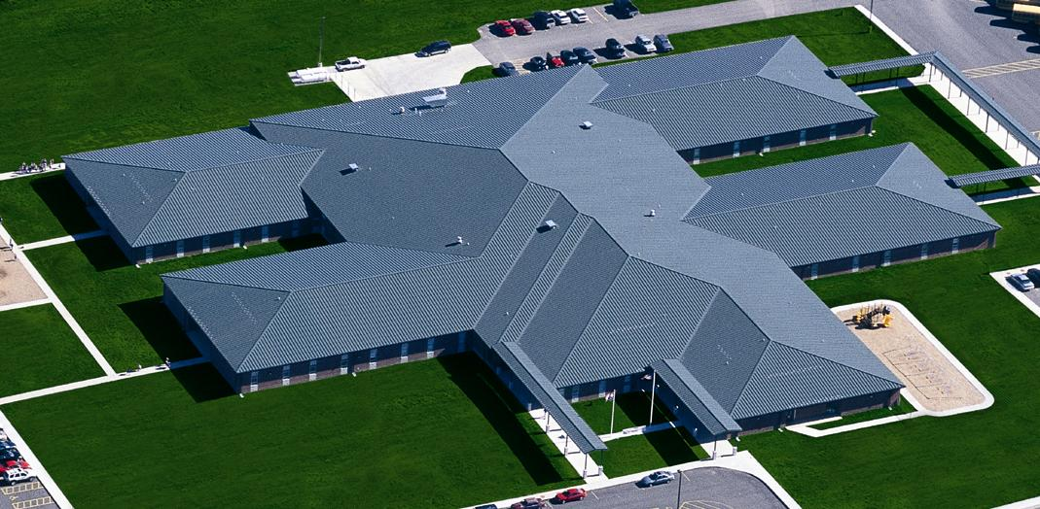
Notes:
John D. Ester Elementary School in Lebanon, MO. This roof is the Standing vertical seam double lock type.

Slide 64
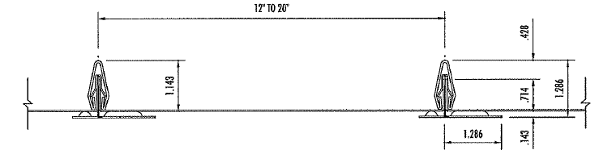
UC-7
Snap-On Standing Seam
Notes:
*** Pass out sample
The Double Lock panel systems are the most traditional style, as I mentioned earlier, they have been around for centuries. Most systems today utilize a sliding clip to accommodate expansion and contraction. Panel installation is sequential with one panel fitting over the top of the next with the clip in between. The seams can then be hand crimped or folded with a mechanical “mouse” that runs along the seam. When sealant is added to the seam you get a watertight seam so these panels are used a lot where watertight warranties are required.

Slide 65
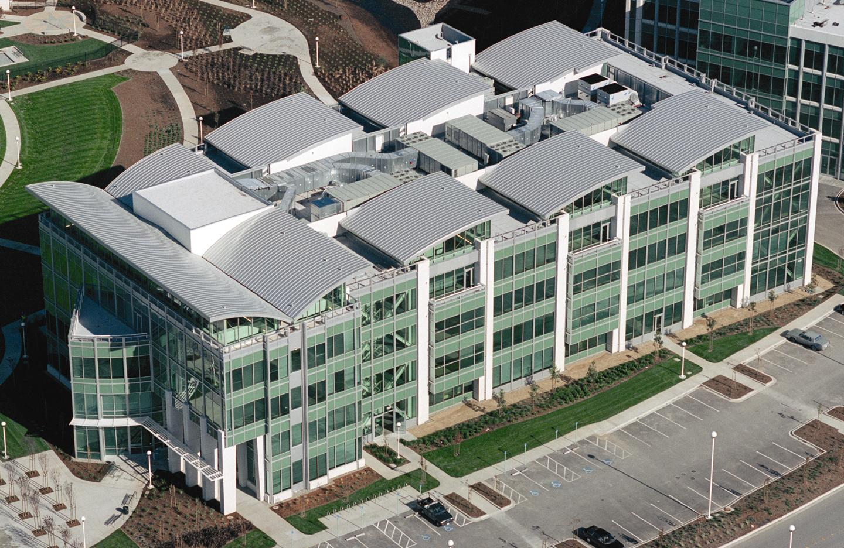
Notes:
The Pacific Shores Office Building Project in Redwood City, CA was so large it was split between 3 different roofing contractors – this is just one of several buildings on the site. The radiused snap on standing seam panels for this project were all manufactured in-house and shipped to the job site.

Slide 66
Radius Standing Seam Roof
Notes:
Radius roof are becoming more and more popular with the new technology available today. The Grand Casino in Mille Lacs, MN is an example of a standing seam radius, the snap on batten style, that was actually roll formed on-site because of the length of the panels. We’ll talk a little later about the pro’s and con’s of on-site roll forming versus in-house manufacturing, but for a project like this one, shipping the panels over the road was probably not a very good option.

Slide 67
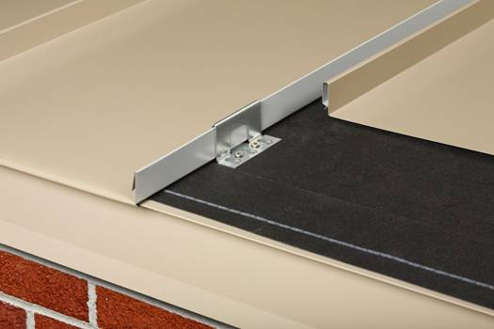
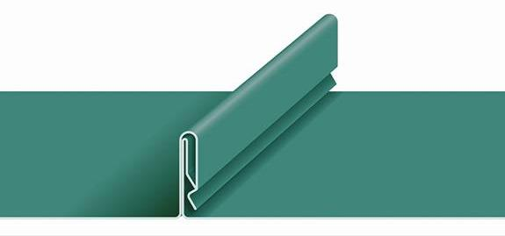
UC-14
Factory-formed panel with an interlocking seam that snaps together over concealed clips
  Accommodates very long runs and virtually unlimited thermal expansion

Slide 68
UC-14

Slide 69
Weather Tightness Warranties
Not all warranties are structured the same
  Read the fine print, exclusions and interpret the meaning
Examples
  Guaranteed not to leak “unless roof system is installed improperly”
  Warranty “Excludes Flashings and Trims”
  Warranty covers panels only
  Many “Weather Tight warranties are pro-rated over time…
  Some Warranties only cover the cost of material replacement, with no labor…

Slide 70
Firestone Metal Warranties
Warranty Offerings
Metal Finish Warranties
Metal System Warranties (Red Shield)
  Panels/Underlayment
  Clips/Screws
  Firestone Brand - It is covered!!

Slide 71
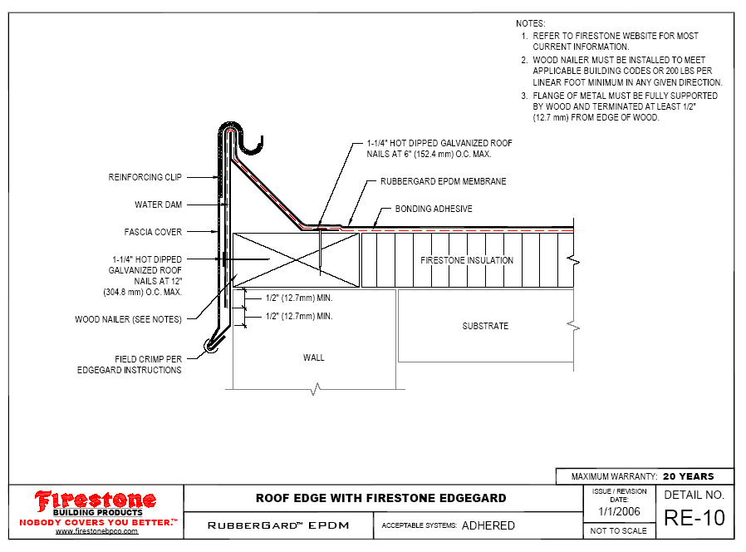
Contractor-Fabricated
Snap-On Roof Edge
(Firestone Detail RE-10 or Similar)
Note: Not suitable for extended wind warranties, projects requiring FM approval, or projects requiring ANSI ES-1compliance.
Material Requirements
UNA-CLAD MATERIALS:
Snap-On Cover &
Splice Plates
OTHER MATERIALS:
Water Dam
Fasteners
Sealants
Min. 24 Ga. G-90 Galv. Steel w/ Kynar Finish
or Min. .040 Aluminum (Painted or Anodized)
Min. 24 Ga. G-90 Galv. Steel
1 1/4" Hot Dipped Galv. Roofing Nails
Firestone AP Sealant
Installation Requirements
Back-edge of Snap-on cover shall be formed upward to avoid cutting membrane (as illustrated in Firestone drawing)
Water dam shall be continuous and fastened 4" O.C. max. with roofing nails.
Min. 8" wide splice plates shall be installed at all connections and intersections.
A continuous bead of Firestone AP Sealant shall be installed at all connections and intersections. (Note: Sealants at metal connections are an owner maintenance item in accordance with Firestone Red Shield Maintenance Guidelines.)
Follow all Firestone drawing notes and an application specifications.

Slide 72
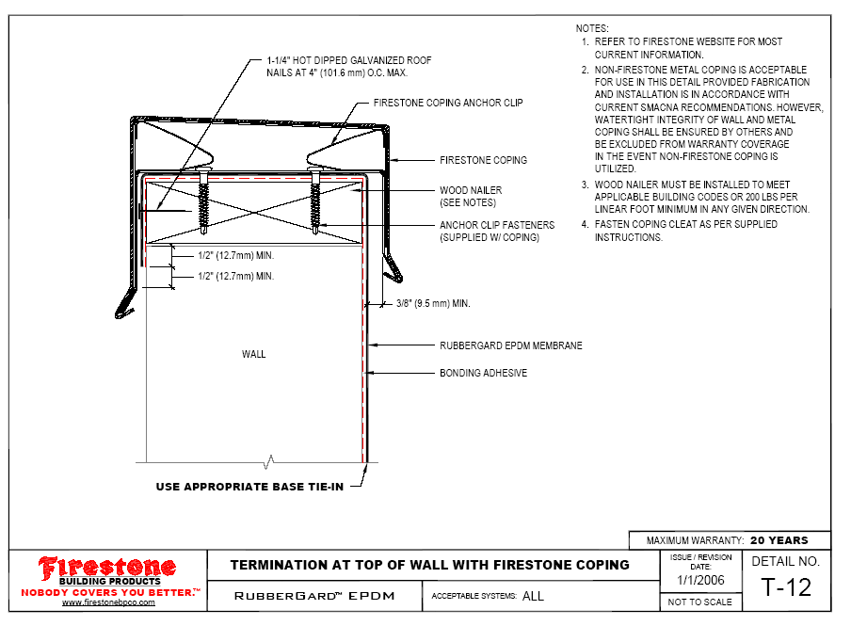
Contractor-Fabricated
Coping
(Firestone Detail T-12 or Similar)
Note: Not suitable for extended wind warranties, projects requiring FM approval, or projects requiring ANSI ES-1compliance.
Material Requirements
UNA-CLAD MATERIALS:
Coping Cap &
Splice Plates
OTHER MATERIALS:
Cleats
Fasteners
Sealants
Min. 24 Ga. G-90 Galv. Steel w/ Kynar Finish
Min. .040 Aluminum (Painted or Anodized)
Min. 22 Ga. G-90 Galv. Steel
1 1/4" Hot Dipped Galv. Roofing Nails
Firestone AP Sealant
Installation Requirements
In lieu of the factory-fabricated spring clip supplied with Firestone Coping, minimum 22 ga. shop-fabricated cleats may be used. Cleats shall be continuous on both sides of the parapet and fastened 4" O.C. max. with roofing nails.
Min. 8" wide splice plates shall be installed at all connections and intersections.
A continuous bead of Firestone AP Sealant shall be installed at all connections and intersections. (Note: Sealants at metal connections are an owner maintenance item in accordance with Firestone Red Shield Maintenance Guidelines.)
Follow all Firestone drawing notes and an application specifications.

Slide 73
Metal Accessory Warranties
Other Options
Facades & Equipment Screens can also be included …
…when designed and quoted by Firestone Metal Products @ FSBP

Slide 74
Metal System Warranties
Type & Availability
Warranty Type: Red Shield
  5, 10, 15, or 20 year standard term
  May be combined with other systems (EPDM / TPO / Asphalt),
  Plus…new 25 year Red Shield Medallion term for UC-4 only
Warranty Availability: Licensed Contractors
  Must be authorized for metal by local sales rep and approved by Regional Sales Manager
  May need to provide a job history of past projects

Slide 75
Metal System Warranties
Technical Requirements
Factory-Fabricated System and Components
  UC-3, UC-4, UC-6 or UC-14 panel systems only
  Fasteners, clips & sealants supplied by factory
  Factory or Contractor fabricated trim with some field options
Installed over Firestone’s or Approved Underlayment*
Follow standard Firestone Red Shield details or details with prior approval from Firestone
Quoted by FSBP – Estimating Services
  Lump-sum quote similar to Tapered Iso
  Requires approved shop drawings & verified field measurements

Slide 76
Metal System Warranties
Contractor Procedures
Receive quote from Firestone Building Products Sales Reps.
Submit purchase order to Firestone Building Products
Submit Pre-Installation Notice (P.I.N.)
Submit shop drawings to Firestone Building Products for review
Complete Installation
Submit RFI

Slide 77
Other Items
Oil Canning
Underlayments
Decks/Substrates
Green Design (Tree Hugger’s delight)
Shipping/Jobsite staging
Hands On!!!

Slide 78
Oil Canning
“Oil canning is an aesthetic issue, not a structural problem or a defect. It is unrealistic to expect any architectural roof or similar wide-metal element to be totally free of some degree of oil canning. While oil canning cannot be totally eliminated, adherence to industry accepted and recognized methods of design, metal specification, handling, fabrication, and installation can minimize its occurrence.”
- 6th edition, SMACNA Technical Manual

Slide 79
Oil Canning
Causes of oil canning
  Coil manufacturing
    Excess material in the middle of the coil strip
    Excess material in the edges of the coil strip
    Camber - coil side edge is not straight
Fabrication
  Slitting of coil for proper panel width
  Less control with on-site roll forming

Slide 80
Oil Canning
Causes of oil canning installation
    Substrates and underlayments
    Out of plane sub – structure
    Stretched seam engagement
    Over - driven fasteners
    Handling

Slide 81
Methods of Control Oil Canning
Stringent specifications for maintaining proper plane of sub-structure
Tension leveling material before forming
(not possible with on-site roll forming)
Design panel with stiffening ribs or Striations
Choosing narrow panel widths
Heavier gauge material
Install Foam Backer Rod @ center of Pan

Slide 82
Tension Leveling (factory)

Slide 83
STIFFENING RIBS

Slide 84
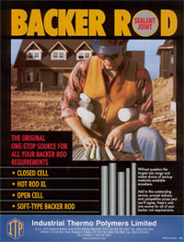
Foam Backer Rod
Backer Rod

Slide 85
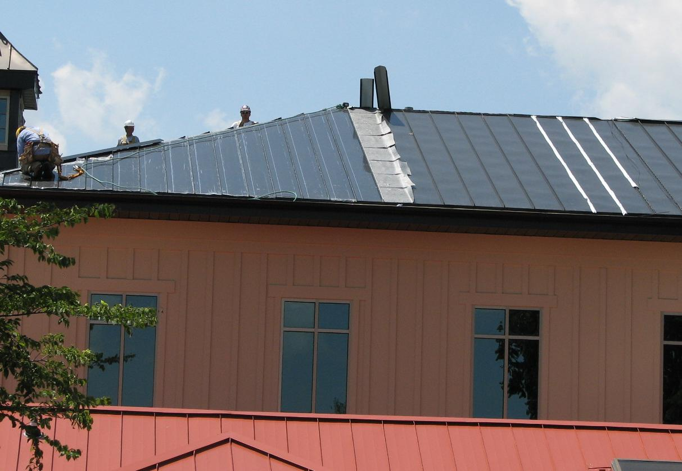
Backer-Rod Works!!!!

Slide 86
How to apply, What Diameter?
After removal from the crate, simply tape a continuous pc. full length of the panel.
If difficult staging (roof height, distance, weather) Backer can be applied prior to panel placement.
Start with ½” dia. Adjust if needed to larger diameter.
This is not a Firestone product, it will not be included in your order…

Slide 88
Green Design
Recyclability
  Copper, zinc, aluminum & steel are all 100% recyclable
  Recycled percentages vary on type of metal and market conditions
Solar Reflectivity
  Deflection of solar energy from the material’s surface
  The greater the amount of solar energy reflected, the less energy the building will need to cool down

Slide 89
Staging the Job
Bundles should be lifted with equipment that supports most of the panel length. (spreaders)
Bundles should be rigidly packaged with crosswise and lengthwise blocking, on level surface.
Protected from contact with other items such as structural components.
PANEL/CRATES NEED TO BE TARPED OR COVERED AFTER EACH DAY!!!!!

Slide 90
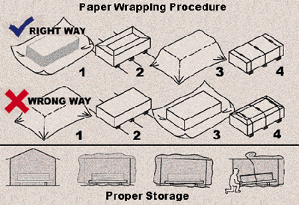

Slide 91
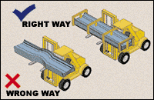
When using a forklift, careful handling and unloading practices should also be used to
Avoid excessive bundle flexing or abrasion of the panels
Forklift forks must be a minimum of five feet apart.
Do not transport open bundles.
Drive slowly when crossing rough terrain to prevent panel buckling.

Slide 92
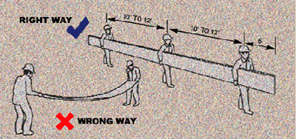

Slide 93
Field Cutting
Minimized by using factory-supplied cut-to-length Panels.
If required use
  Straight blade shears, profile shears, nibblers or hand snips.
Clean-cut edge without damaging the paint or metal coating.
The shear blades should be kept sharp to minimize burrs
DO NOT cut with an abrasive wheel, hacksaw, or other cutting tools!!!!

Slide 94


Slide 95


Slide 96


Slide 97


Slide 98


Slide 99


Slide 100


Slide 101


Slide 102


Slide 103


Slide 104


Slide 105
Firestone Building Products
www.firestonebp.com
www.unaclad.com

